Slide 1
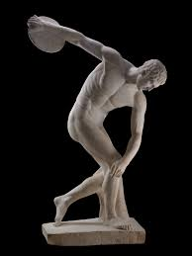
Body as the Locus of Knowing

Slide 2
Overview
I. Introduction :
Practical and theoretical forms of knowing, Plato and the Greeks
II. Body and the practice of knowing – Implicit knowing versus method
II. The Social and Cultural Body – the Body as Gendered

Slide 3
Work-shop
What is the role of the body in knowing things?
Is there specific “knowing of the body”?

Slide 4
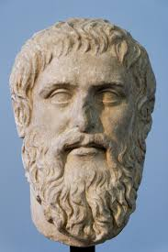
I. Practical and theoratical knowing
Plato:
- Knowing as a forms of tehné; art, craft and tghe work-shop
-Poiesis and techné
- Knowing as Logos, as explicit articulation and justification, making sense…
- Knowing as the making explicit of eidos, forms and function.
Aristotle:
- Knowing in praxis; deliberation in action, phronesis.
- The good
- Action, knowledge of virtues as relational goods
- Action as revealing... Disclosure of a situation. Practical insight, knowing in action.

Slide 5
Western conception:
Method preferred as locus of knowing;
Explicit over implicit or tacit knowledge
Downgrading of the role of the body
Intellectual knowledge as mark of expertise
Modern view:
Knowledge as explicit self-reasurrance and evidence on the model of matematics...

Slide 6
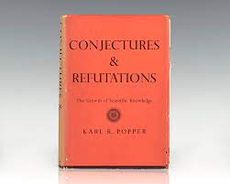
II. Two Conceptions of knowing
A. Inferential knowledge
Method as the testing of hypothesis (Karl Popper)
Inference:
If a then B…
Not B
Not A
Knowledge as the progressive culmination of hypotheses that withstand critical testing and experiment
Inferential justification of knowledge and progression

Slide 7
B Practical knowledge
A. Karl Polanyi:
Knowing how – knowing that
Knowing that; a attribution of a mode or status in knowing, of reliance and competence… not itself the course of action
Knowing how
Implicit tacit skills, knowledge of a situation, of carrining through…. E.g. Bicycling
Heidegger’s work-shop, revealment as ready-to-hand, practical engagement…
Knowing that
Reflexive self-reassureance of a competence or self-reliance
“I know that I am capable of…”
Or, neutralization and transformation of use-thing to object… logical and inferential determination (Heidegger’s hammer)

Slide 8
Nature of tacit knowledge in action
A. Gestalt. Specific fore-ground back-grond-structure.
In action; background, motivational without being in focus or presence.
Immediate adjustment of posture and body-schema (Merleau-Ponty) to the surroundings of “affordances”, enabling the course of action/behaviour.
Unity of acting subject and the world (coupling).
Lived body and lived significance (Merleau-Ponty).
B.
The world, not yet object, but revealed or disclosed in accordance with the lived body in action…
Knowing: a matter of making things show up or appear
(example, outlines, planes, figures…)
Affordances:
Gibson, The Ecological Approach…
Perceived features disclosed in modulating bodily skills and motor capacities (adaption to environment)
Body, discloses a niche of perceived significance revealed in action
Lived body, Husserl, Sartre, Merleau-Ponty

Slide 9
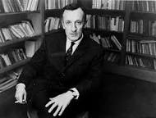
Excursus on the lived body
Merleau-Ponty
“I am not in front of my body, I am in my body, or rather I am my body”.
Fore-ground backgroind:
“For the player in action the football field is not an ‘object’ [...] The field itself is not given to him, but present as the immanent term of his practical intentions; the player becomes one with it and feels the direction of the ‘goal’, for example, just as immediately as the vertical and the horizontal planes of his own body.”
“Every external perception is immediately synonymous with a certain perception of my body, just as every perception of my body is made explicit in the language of external perception”
- The lived, affective body engaged in projects, in the world…
- Not the body as object among other objects, but as locus of action, perceiving and meaning… (the living body as experience and a point of view).
- Body-schema bvs. Body-image
implicit affective organization of the body in terms of posture, balance and action. E.g., walking. The body finds balance in movement forwards, adjusting posture to ground…
Correspondences between body-schema and the perceived world…

Slide 10
Knowing that
Explicit knowledge; “this is a round table”.
Based upon the modulation of roundness in perceiving action, skill in revealing (indeterminacies and openness)
Narrowing down and neutralization through an explicit claim or judgement; this is thus and so…
Symbolic openness to inferential determination… individual, class, species etc.
All explicit knowing, know that, depends upon implicit tacit use of skills, “make things show up with a certain relevance”.
Knowing that… itself a matter of knowing how. Making something explcit in communicative interaction…
Practices of sense-making, and intersubjective practice of mutual understading in language…
Altered fore-ground and background structure
Background: the life world or field of tacit knowing and skills that reveal possible significance…
Dialectical relation

Slide 11
Knowledge and expertise
Kinds of knowledge worlds:
practical knowledge: practical skills.
Ethical world: knowing how to perfect the good… in action (politeness, generosity, kindness, empathic concern etc,)
Social sciences: theory and testing of hypothesis, n ot just a matter of inferential knowing, but of a dialectical grasp of significance and value disclosed pre-theoretically
e.g., understand how economic concepts, calculations and “laws” (market, profit, exchange, growth etc.) depends upon the real relations of economic practice, and how this practice evolved is is sustained by bodily action and interaction (e.g. work, needs, lived value).
Natural sciences: dialectical relation between conceptual formation, predictions, and the tacit practical interventions that are part of an experiment (/and the backgound of tyhis in the life-world), also related to the use of technology (making things appear in a laboratory).
Aspects of expertise
Capacity for instructing through exemplary action
Takes delight in realizing the good, showing through exemplary action
Ability to ask the right questions with respect to significance…
Ability to traverse the different levels of knowing involved,
Critical of reifications
- Inventiveness and spontaneity

Slide 12
Work-shop
Much of the sciences deals with “abstract entities” and conceptual denotations that are only available from within a specific framework (electrons, exchange-value, social institutions etc.).
One might say such concepts have exclusively an inferential value, that is, they can be inferred from within a system of concepts and measurements.
To what extent might we say that such concepts (exchange-value, social institutions) involve tacit knowing and the lived body?
And how does science itself, such as economics or pedagogy, take part in the life world of lived bodies?
Try to reflect on this latter question from the point of view of your own project and field…

Slide 13
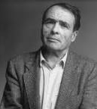
III. The Social Body and Gender
A. The body as locus of social structure and lived meaning (personal life-world).
B. The Gendered Body

Slide 14
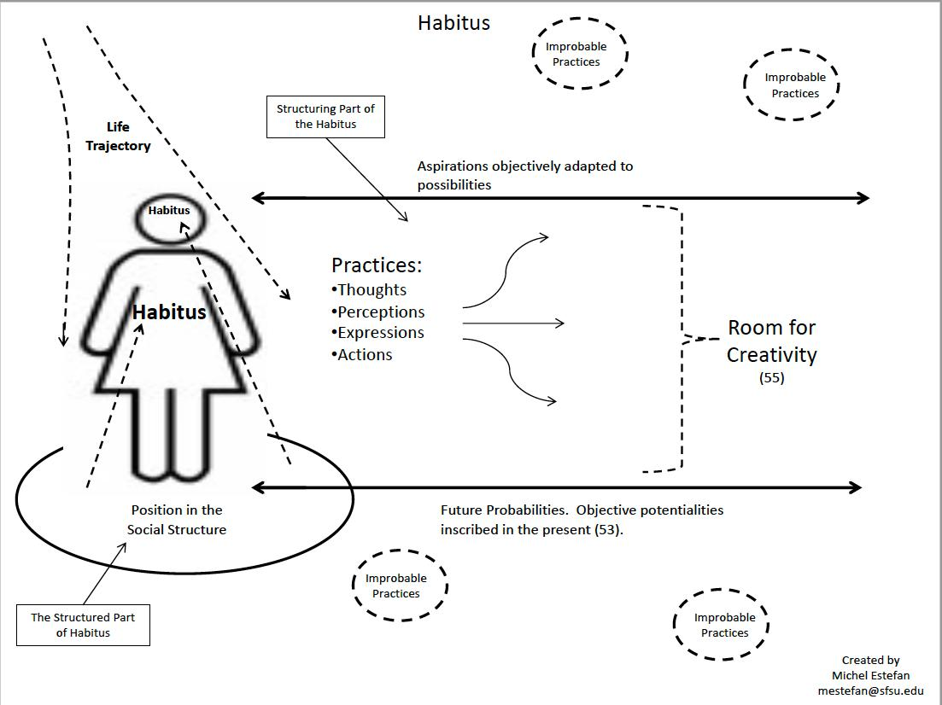
a. The Body as Habitus
Habitus and
1. The imitative child and incorporation of social dispositions…
Todays research: Primary imitation…
2. Doxa-Hexis, body as social practical sense, coping.
3. Social class
4. Habitus, style, room for variation

Slide 15
Body and social space
“The habitus is precisely this immanent law, lex insita, inscribed in bodies by identical histories, which is the precondition not only for the co-ordination of practices but also for practices of co-ordination”.
“The child mimics other people's actions rather than 'models'. Body hexis speaks directly to the motor function, in the form of a pattern of postures that is both individual and systematic, being bound up with a whole system of objects, and charged with a host of special meanings and values”.
“The body believes in what it plays at: it weeps if it mimes grief. It does not represent what it performs, it does not memorize the past, it enacts the past, bringing it back to life. What is 'learned by body' is not something that one has, like knowledge that can be brandished, but something that one is.”
“For example, the opposition between movement outwards, towards the field or the market, towards the production and circulation of goods, and movement inwards, towards the accumulation and consumption of the products of labour, corresponds symbolically to the opposition between the male body, self-enclosed and directed towards the outside world, and the female body, which is akin to the dark, damp house full of food, utensils and children, entered and left by the same, inevitably soiled opening. 15
The opposition between the centrifugal male orientation and the centripetal female orientation, which is the principle of the organization of the internal space of the house, no doubt also underlies the relationship that the two sexes have to their own bodies, and more specifically to their sexuality.

Slide 16
B. The gendered body
Bourdieu
“...the specifically feminine virtue, lah'ia, modesty, restraint, reserve, orients the whole female body downwards, towards the ground, the inside, the house, whereas male excellence, nij, is asserted in movement upwards, outwards, towards other men.”
Young, Throwing like a girl
A. Throwing and the cultural body
Femine body, no use of lateral space.
Strauss: feminine body (quotation).
Body schema and self-image…. Beauvoir, the myth of feminine essence…

Slide 17
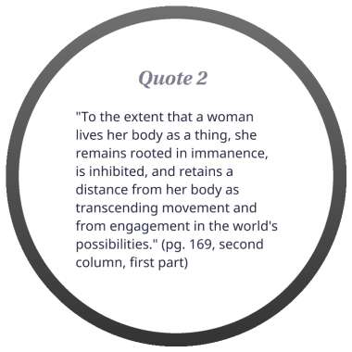
Strauss
“The girl of five does not make any use of lateral space. She does not stretch her arm sideward; she does not twist her trunk; she does not move legs which remain side by side… A boy of the same age, when preparing to throw, stretches his right arm sidewards and backward … twists, turns, and bends his trunk and moves his right foot backward. From this stance, he can support his throwing almost with the full strength of his motorium…”

Slide 18

Young
Inhibited motility
Ambiguous transcendence (hyper-awareness of one’s body)
Inhibited body-intentionality
Discontinues unity…
B situation
Feminine posture, comportment; an implicit practical knowing that reveals the world in a particular way…
Both positive and negative resources of experience and knowledge…
“Typically, the feminine body underuses its real capacity, both as the potentiality of its physical size and strength and as the real skills and coordination which are available to it. Feminine bodily existence is an inhibited intentionality, which simultaneously reaches toward a projected end with an "I can» and withholds its full bodily commitment to that end in a self-imposed“I cannot”.”
“The modalities of feminine bodily comportment, motility, and spatiality which I have described here are, I claim, common to the existence of women in contemporary societyto one degree or another.They have their source, however, in neither anatomy nor physiology, and certainly not in a mysterious feminine "essence.» Rather, they have their source in the particular situation of women as conditioned by their sexist oppression in contemporarysociety.”

