Slide 1
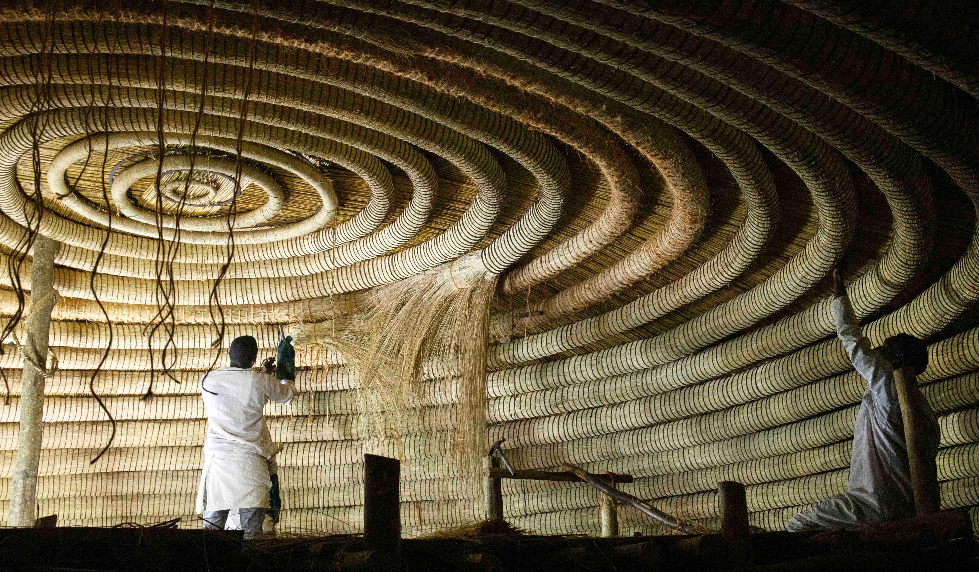
What is to be done about African Studies?
KULT8851/0: Theories of Science
Between iconoclasm and colonial legacy

Slide 2
The archetype of colonial knowledge
African studies born out of the colonial era, to facilitate the exploitation and later administration of the continent by imperial power.
Underscored by racist and modernist paradigms
Concentrated within institutions in Europe defined by a (large) geographical area rather than disciplines or methods: the Royal African Society (1901), the Académie des Sciences Coloniales (1922) or the Société d'Etudes Coloniales (1894) and the Institut Royal Colonial Belge (1928)…
Often poor scholarship, obsession with cataloguing over analysis, sometimes outright fiction.
Colonialists were the subjects. Colonised peoples the object. Subjectivity denied to Africans.

Slide 3
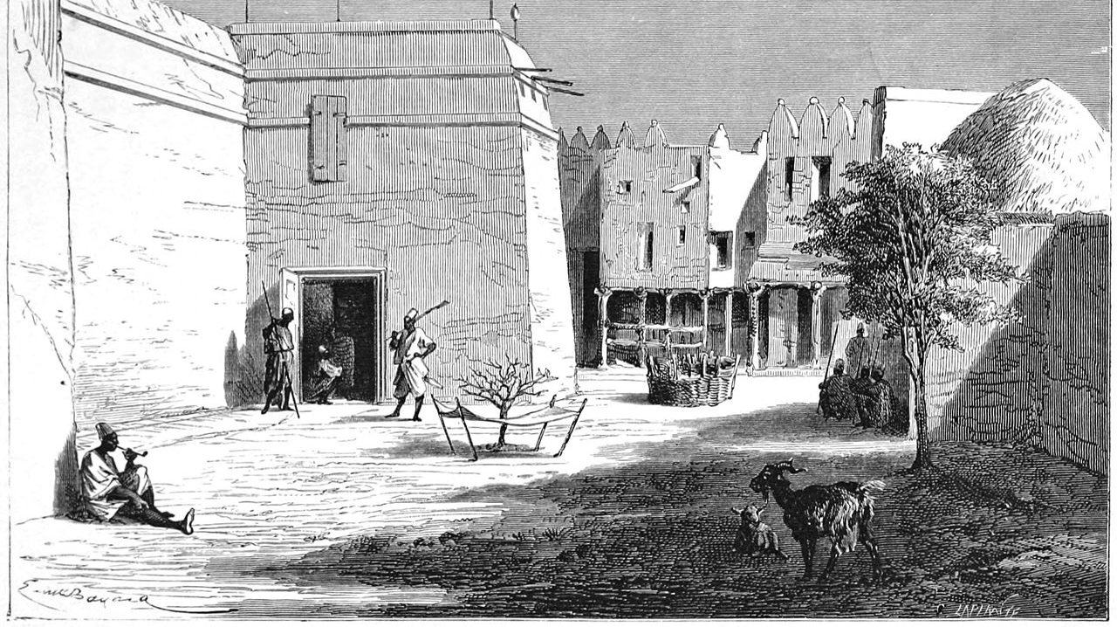

Slide 4
Coloniality and knowledge production
The way the colonial experience influences knowledge production and epistemologies is sometimes dubbed “coloniality” per the works of Peruvian sociologist Aníbal Quijano.
With the gradual emergence of a new World System centered around Europe and the Atlantic from the 15th century onwards, new representations, ideologies and paradigms also emerge.
These ideologies and paradigms, are both products of this new system and necessary to sustain it – they are part of the superstructure.
This defines how knowledge production works and for what purpose. Here : legitimizing the colonization of the periphery.

Slide 5
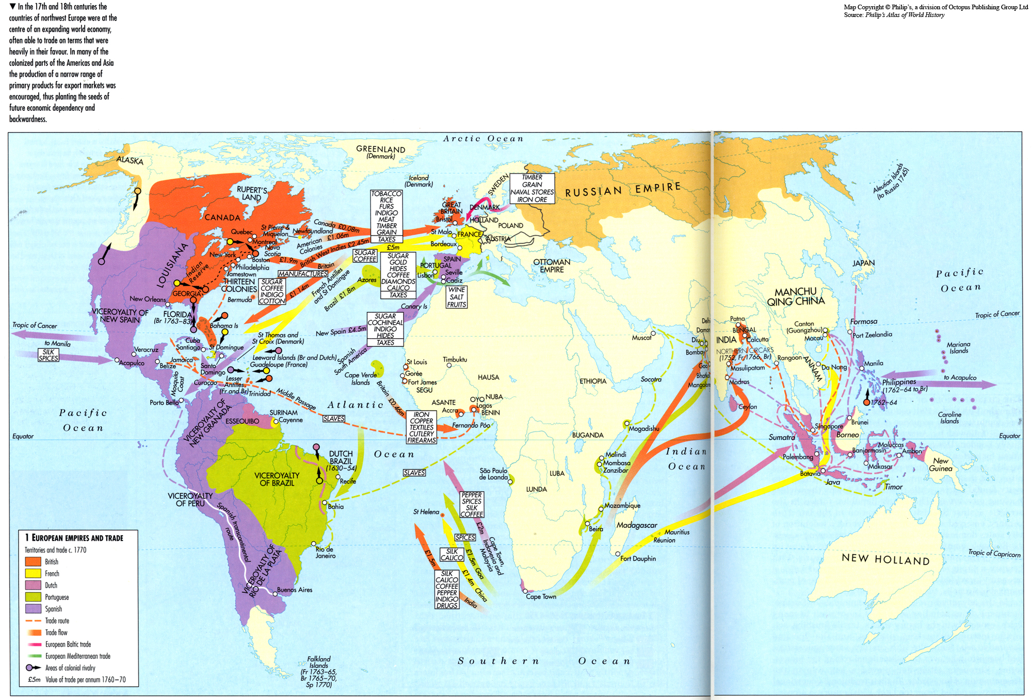

Slide 6
The myth of the dark continent
In the 19th century, in the years leading to the Conference of Berlin and amidst the “exploration” of the African continents by Europeans, a myth is constructed – that of the Dark Continent. A purposeful construction destined to ideologically justify colonisation. It more directly concerns Central Africa and the hinterlands, and presents Africa as an unknown, savage and dangerous place, cut off from civilisation. Cannibalism plays a big role for some reason. This representation is still prominent today.
From the Middle Ages onward, several European and Asian communities had thrived inside of the Continent for centuries, in kingdoms like Kongo or Mutapa. In Western Central Africa, Capuchin priests were continuously present during two centuries before the Scramble for Africa. Africans themselves travelled within and out of the continent (willingly or not), with East Africans being for example a common sight in Western India.
Henry Morton Stanley was certainly not the first person of European descent to cross the continent. Luso-African traders regularly linked both oceans a century before.
The forested areas of the continent, often represented as a “green hell”, were rather desirable. They provided ample and varied reserves of food, resources for cloth production, and well-connected river systems for trading. Forested regions also provided shelter from slave raids.

Slide 7
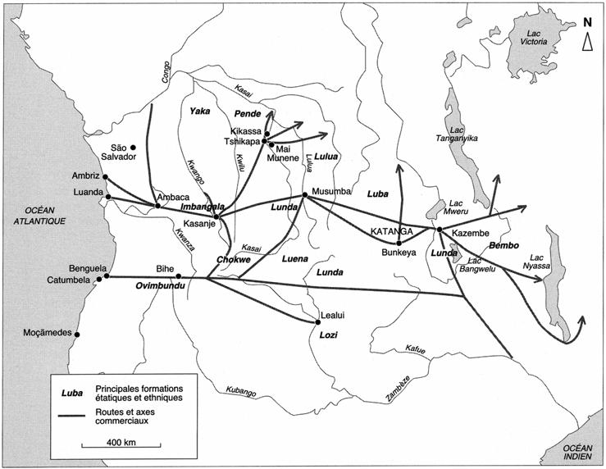

Slide 8
The invention of the tribe
The process of modern colonisation is one of transformation of local economies into simple pools of resources and labour to be exploited by the metropole. This means proletarianization, de-industrialisation and expropriation to facilitate capitalist investment and extraction.
This requires studying, classifying and labelling the local population.
Different groups find themselves divided, sometimes arbitrarily, into “tribes” or similar labels, to facilitate their administration.
This process led by colonial administrators and ethnographers, essentialises ethnicities for the purpose of colonisation, and fails to represent how pre-modern people usually viewed belonging as a matter of kinship or clientelist allegiance rather than ethnicity.

Slide 9
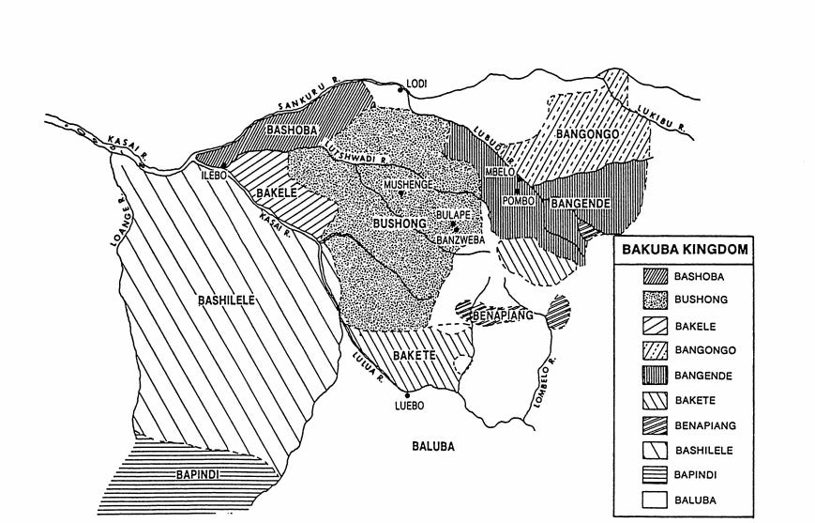

Slide 10
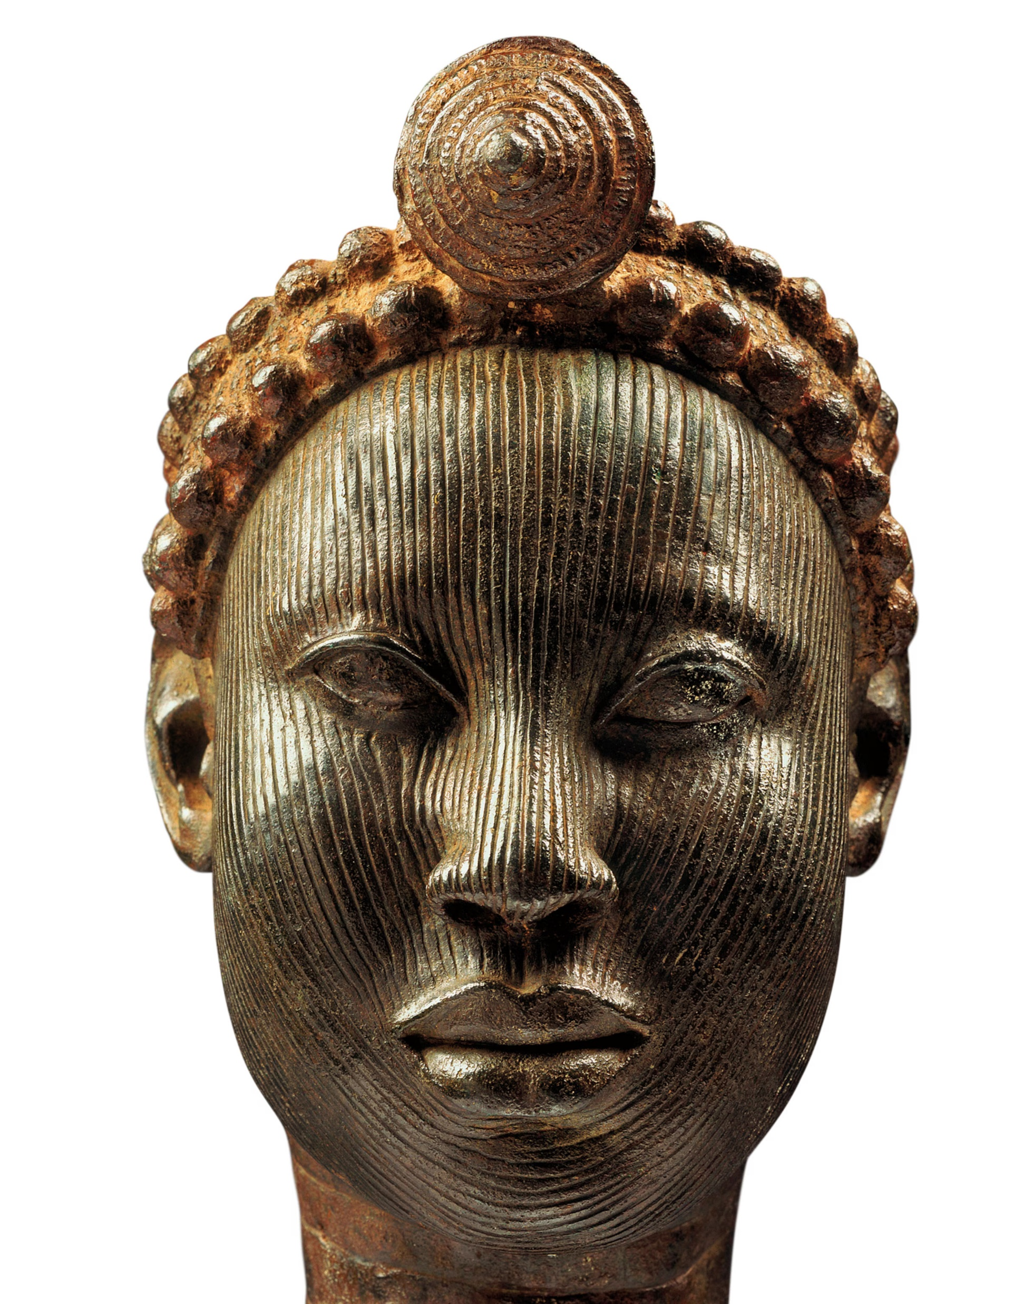
The Arabs did it
Upon (re)discovering numerous African monuments and other achievements within the continent, European explorers and s scholars systematically attributed them to external actors.
  The Bronzes of Ife? The Ancient Greeks
  The Churches of Lalibela? The Sabaeans
  The Palace of Kilwa? The Shirazi
  The Walls of Zimbabwe? King Solomon
It did not matter that Jerusalem and Great Zimbabwe are 7000 km apart. This was superseded by the necessity to construct the belief that Africans were unable to build any civilisation of their own.
Africa is extremely diverse and often its cultural landmarks are the result of exchange and hybridization. But recent studies systematically reveal how previously undervalued native elements were foundational to stuff like Ethiopian architecture or Swahili culture.

Slide 11
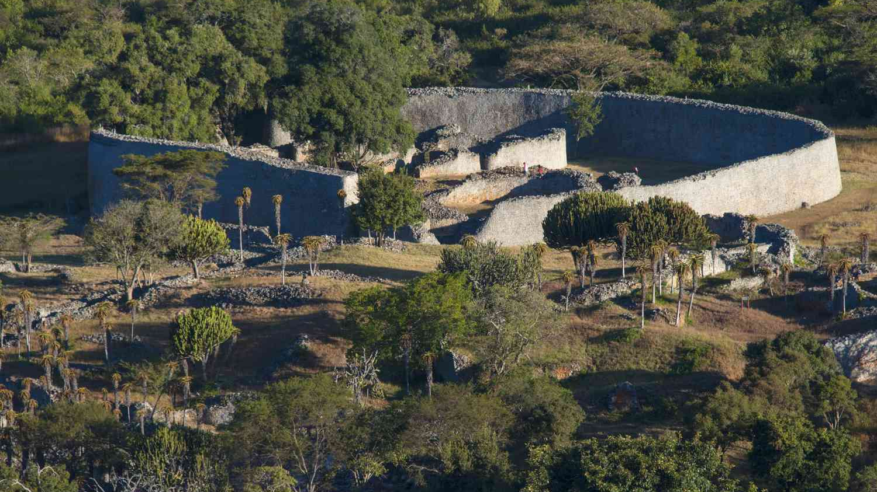

Slide 12
Terra Nullius
Another systematic trend of colonial knowledge production is the systematic underestimation of the ancientness of the settlement of colonised peoples on their land, or that there were there at all.
The most prominent example is the claim that most of the Cape region was empty upon the arrival of Dutch settlers in 1652.
Aside from archeological evidence left by both urban and pastoral societies in the region, the Cape region was strategic because local Khoekhoe communities provided supplies (fresh water and beef mainly) to European vessels en route to India.
The region was valuable and heavily contested. The Europeans waged two wars against the Khoekhoen in the 17th century, followed by nine wars against the neighbouring Xhosa Kingdom between 1779 and 1879.
However, the idea that the region was empty was used as a justification for land distribution during the apartheid regime and is still touted by South African white supremacists today.

Slide 13
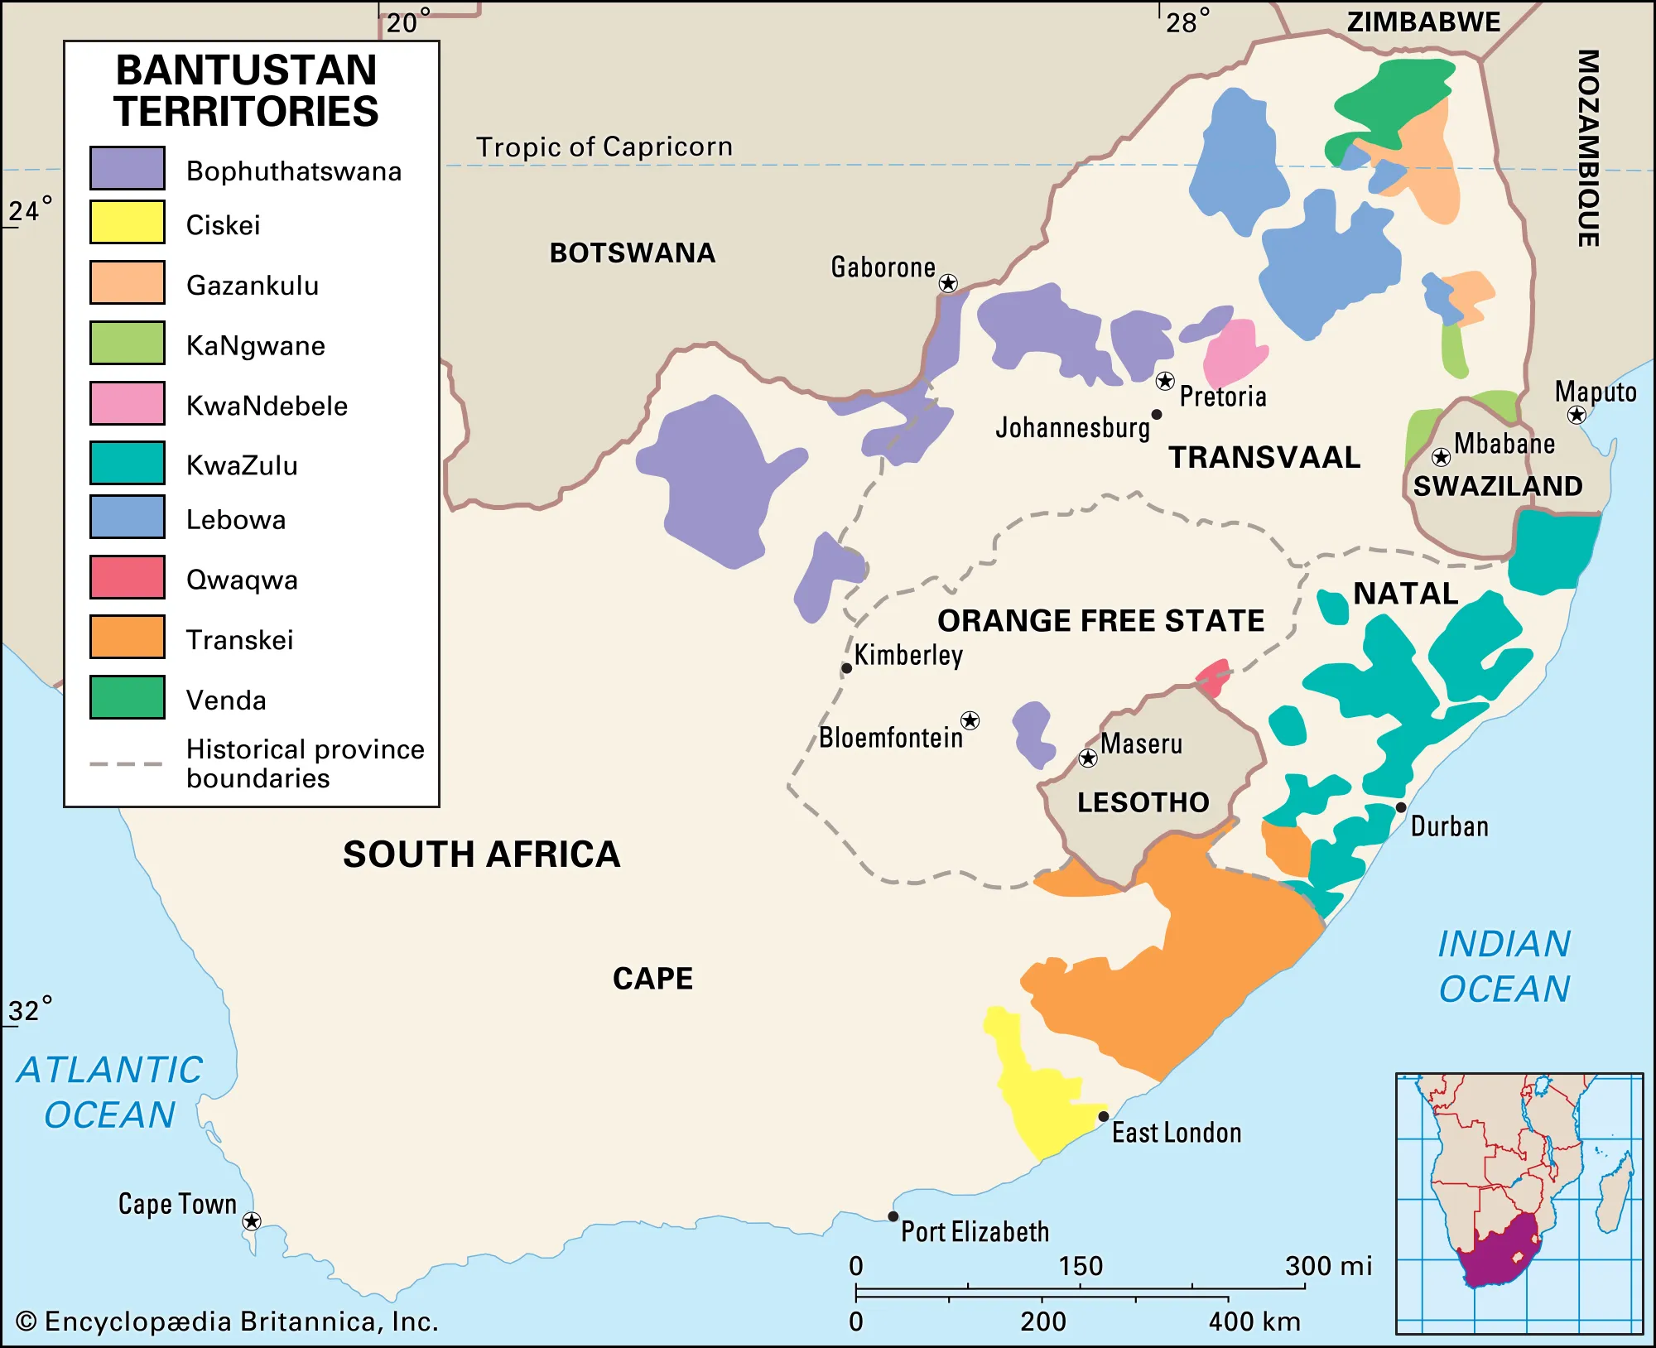

Slide 14
The colonial fiction of Africa
Colonial knowledge production wasn't intended on creating adequate science for its own sake. It was motivated by a search for prestige, and the needs for tools to facilitate the implementation of colonial rule.
It came with its own legacies inherited from the colonisation of the Americas, like that of the frontier ideology, the idea of a virgin continent, or the obsession with cannibalism.
Through discourse and colonial science, Africa got turned into a vast land of immobility and chaos, ancient barbaric traditions but also recent history, in need of permanent external intervention.
This popular image of Africa is obviously contradictory.

Slide 15
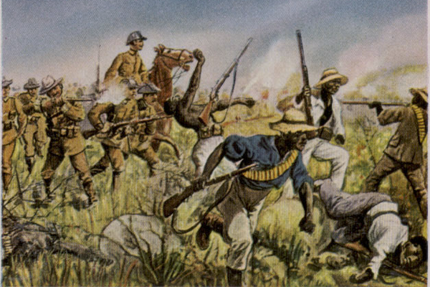

Slide 16
The Afrocentrist counterattack
In the 19-20th centuries, Afrodescendent scholars in the Americas and Africa started to include a reappropriation of their history to their general projects for civil rights.
One of the key fronts in that project was the recentring of Ancient Egypt as an African civilisation, to mirror the symbolic position Ancient Greece holds in European imagination.
Though stimulating, that focus is a dead end: it is itself partially informed by Eurocentrism, takes attention away from lesser-known civilisations and is potentially essentialising.
It also drove a wedge between Subsaharan and North African historians.

Slide 17
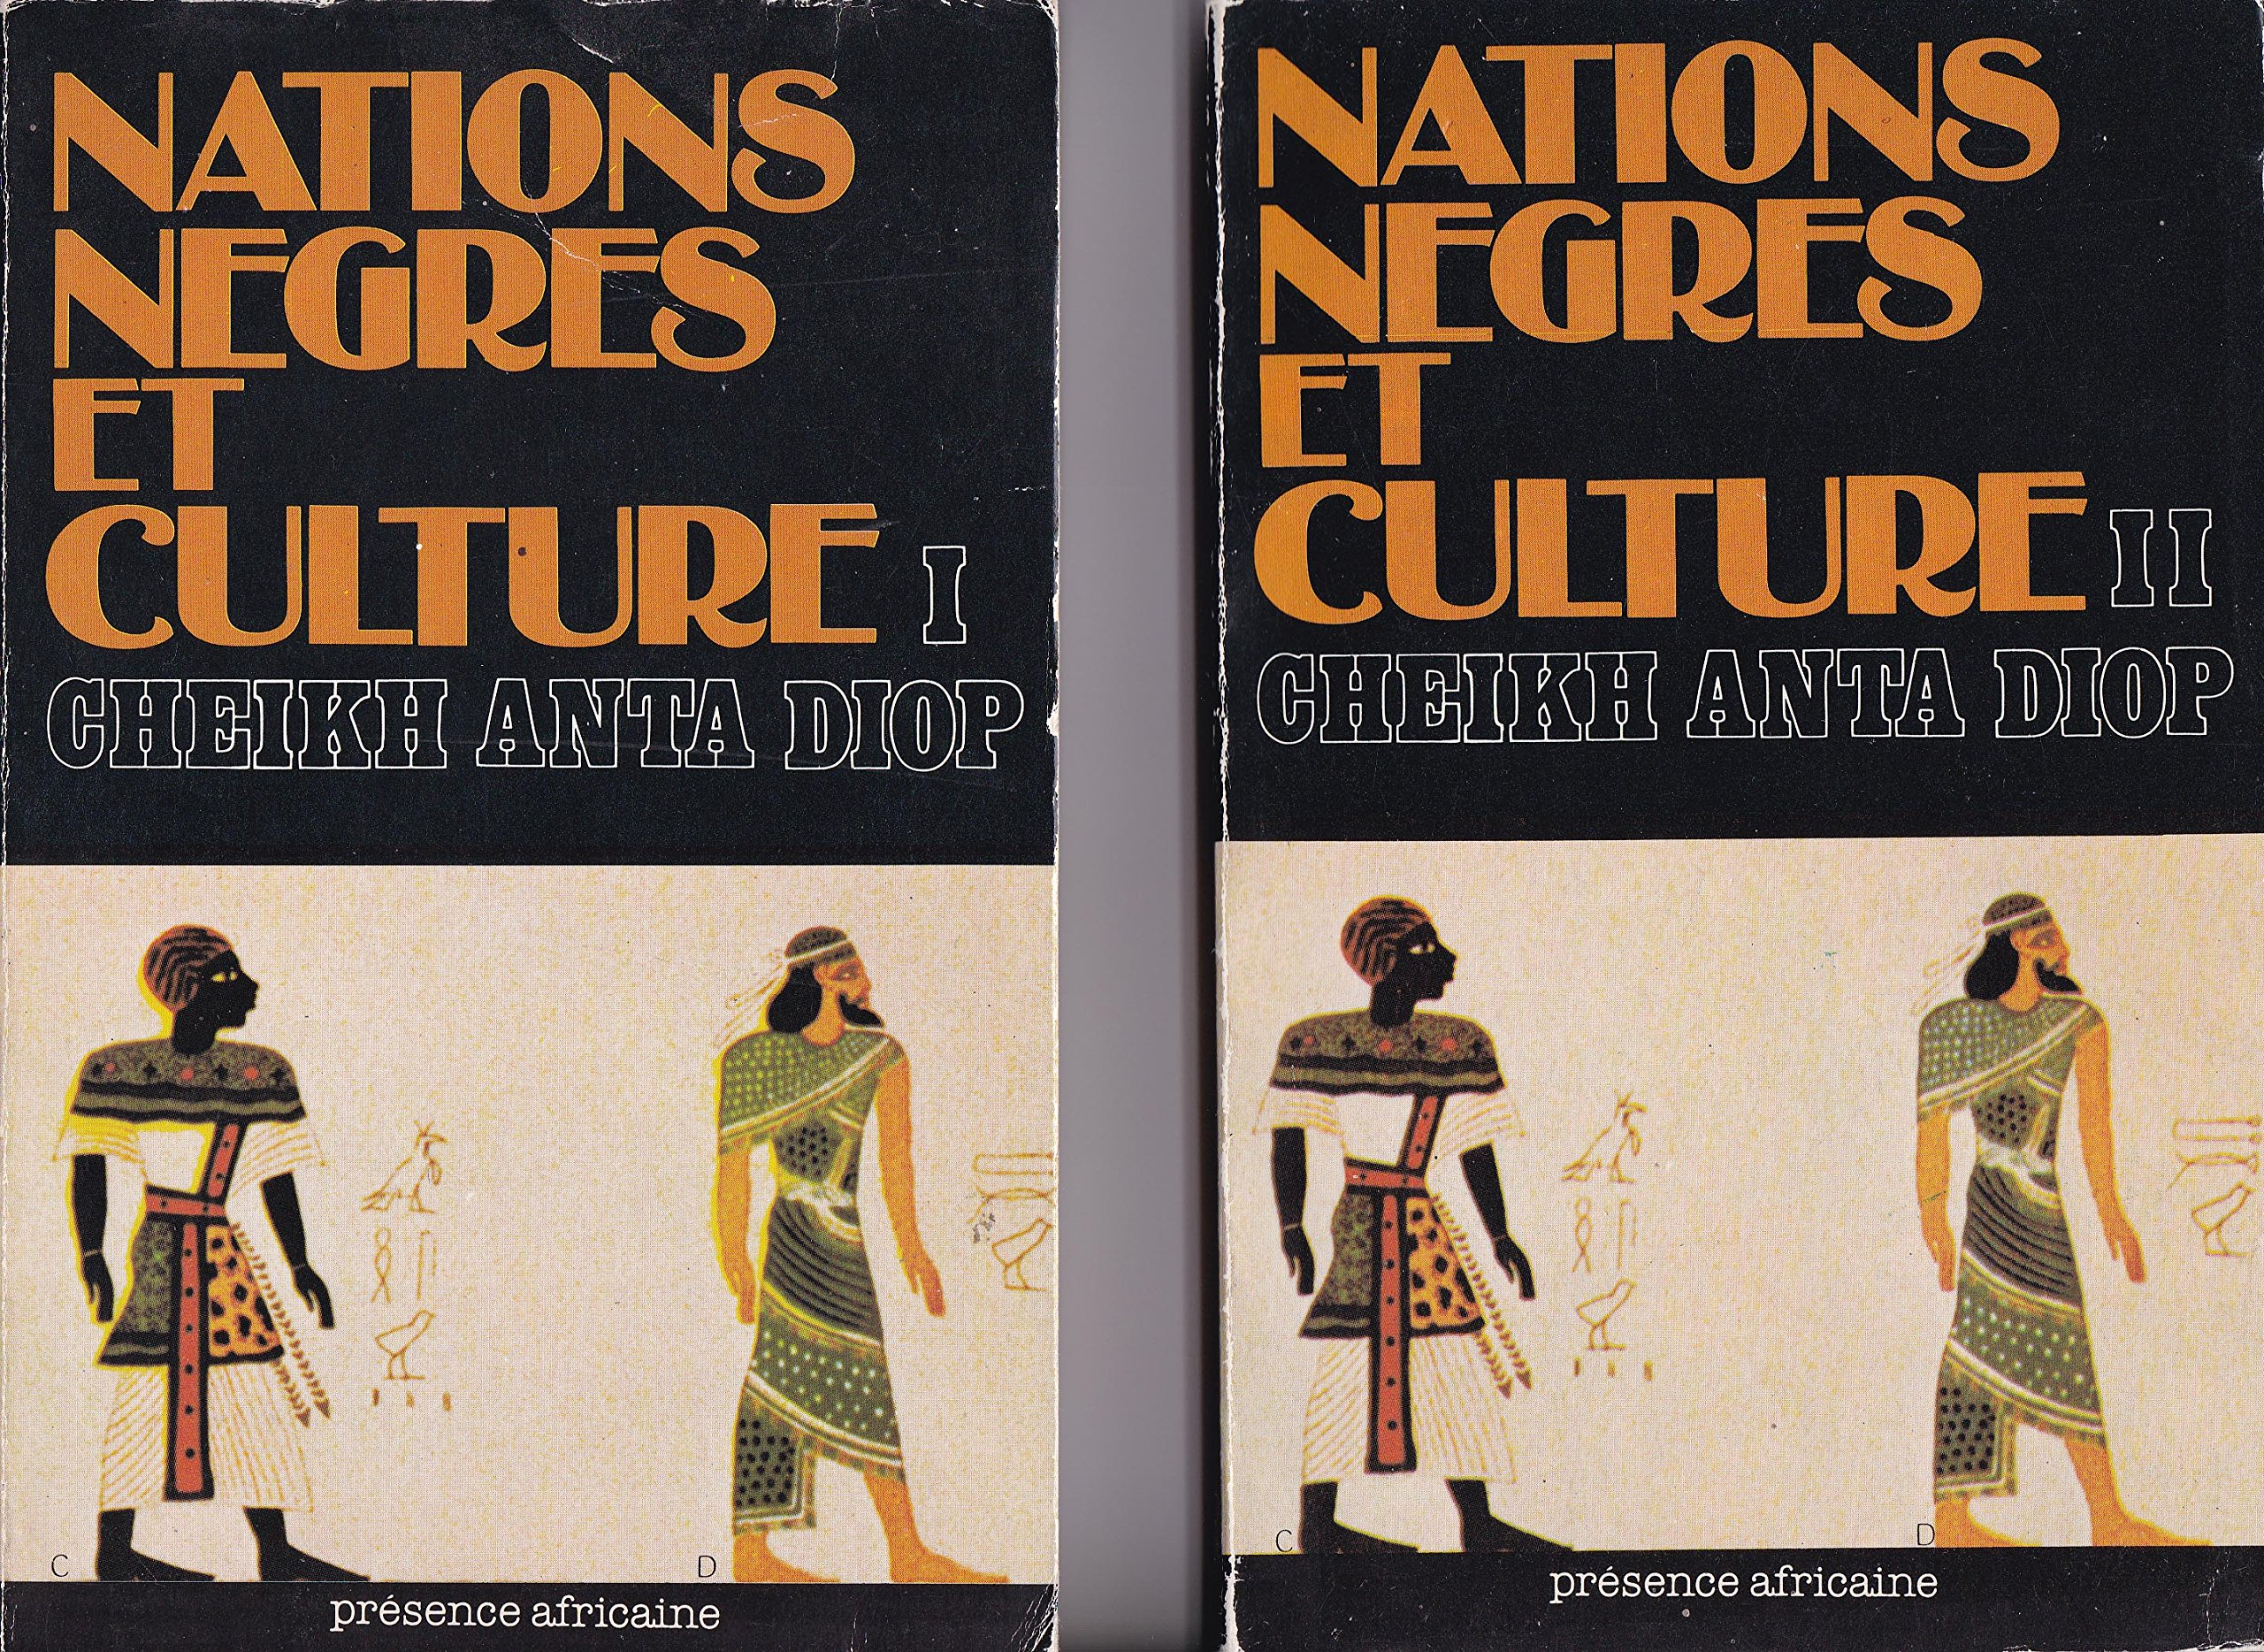

Slide 18
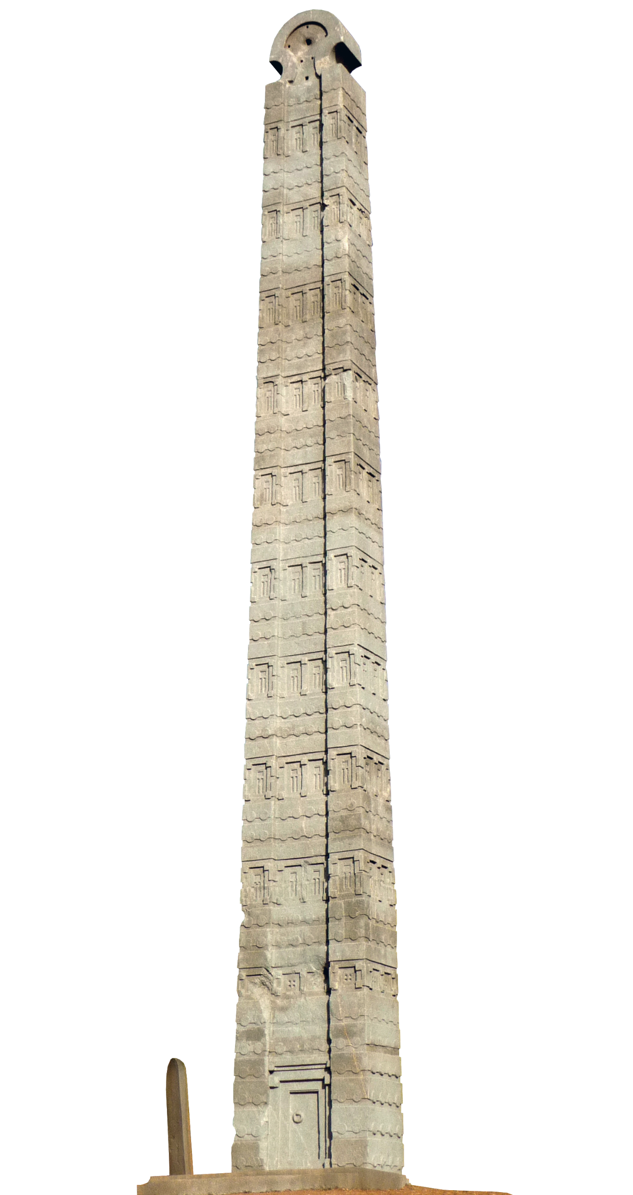
Going beyond
African studies has thus long been dominated by perspectives shaped by racism and contempt, and politically motivated by the need to enforce and maintain colonisation.
The response hasn't been always adequate.
This results in a field that has had to reinvent itself several times, and one where previous works have to be regarded with additional skepticism.
Yet, African studies is still capable of producing valuable original work. Let us see what assets it can rely on to overcome this past.

Slide 19
Crossing perspectives
We often only get from the past what its ruling classes left us.
This often gives us a one-sided version of what a society is or was.
It might be useful to look into dissident voices or other perspectives.
Schools like the Annales in Francophone academia, and the Subaltern Studies in Anglophone academia have for example tried to bring the counter-balance our focus on dominant voices by, respectively, focusing on social-economic history or political minorities (race, ethnicity, class, gender, sexual orientation and identity)
The mainstream is often only that. And looking at contemporary critics, complementary alternative sources or subaltern perspectives offers a richer overview.

Slide 20
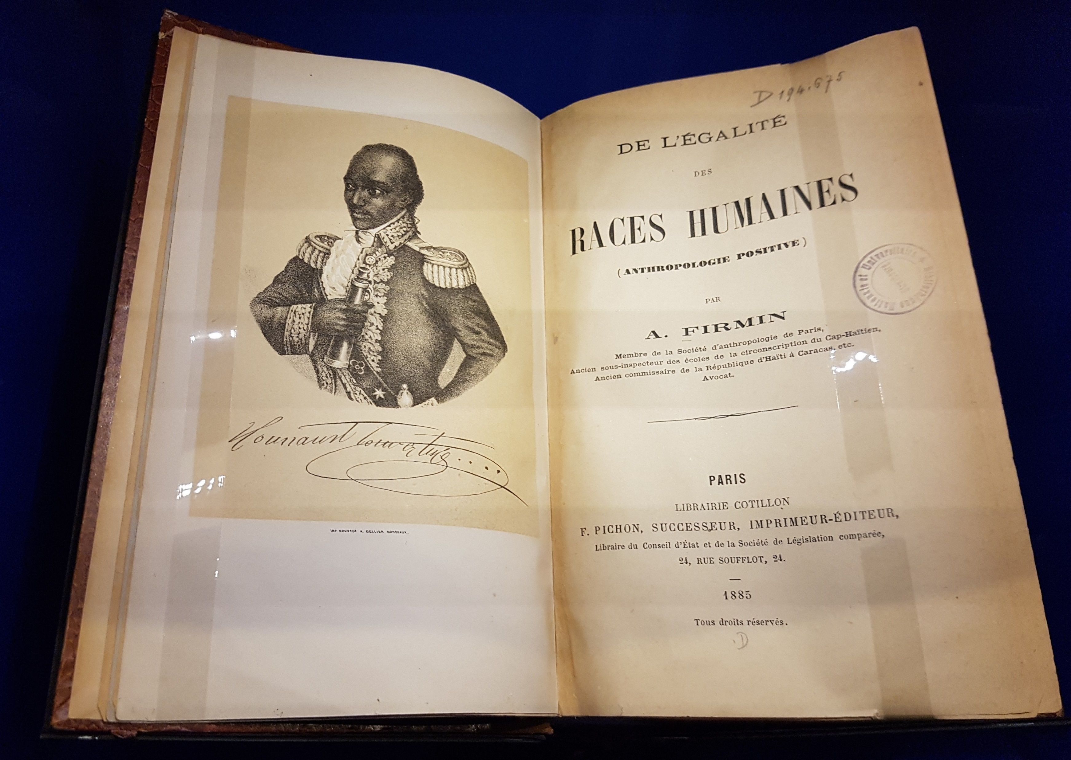

Slide 21
Centering African sources
Because many African societies were illiterate, it is often assumed that lack of sources is the main obstacle to researching African history.
It is only partially true. A variety of texts do exist, as Africa possessed many writing systems (from Ge'ez to Ajami) and centres of learning. From the 15th century onwards, illiterate rulers also often employed to European and Asian secretaries to conduct foreign relations.
And due to recent efforts in digitalisation, more sources are available than ever! It is now easier for laymen and researchers to access manuscripts by rulers, scientists and clerics of Africa's past.

Slide 22
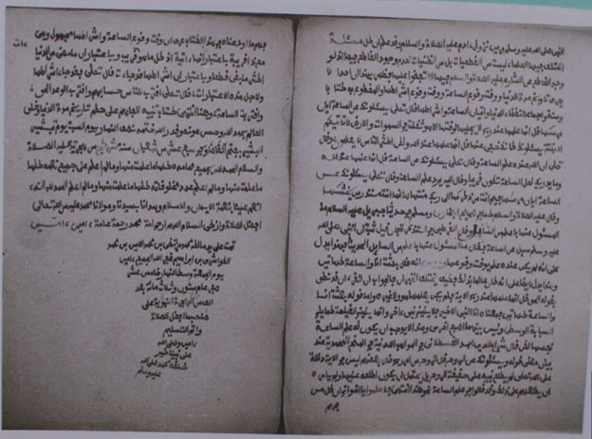
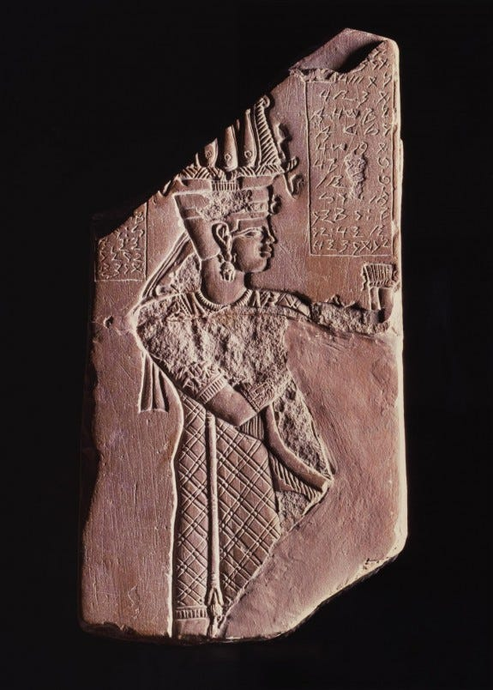
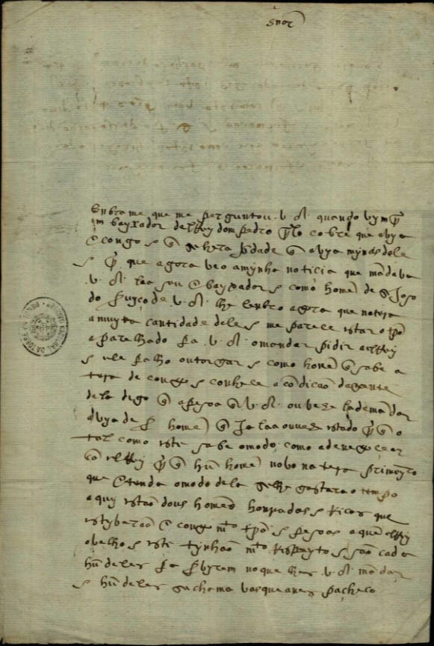
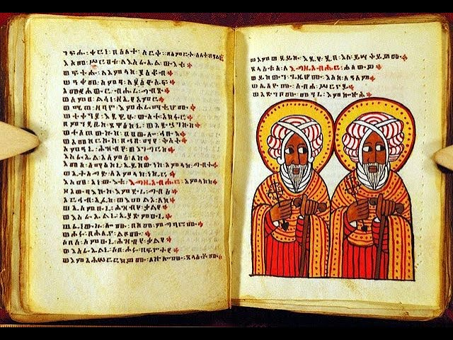
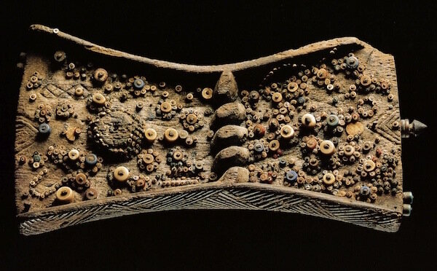

Slide 23
Outside sources can't be discarded
Though local sources remain a must, they are often missing. Sources by outside observers are a historian's second best bet.
There are also more of these than generally thought. Our best informants are Arab travelers, followed by European merchants, who would visit Subsaharan Africa as early as the late Middle Ages.
Both slavers and abolitionists visited parts of Africa and documented it – for different purposes.
Later accounts are often tainted by racism and colonial ideology.
Critical analysis of the sources and cross-referencing remain the best tools.

Slide 24
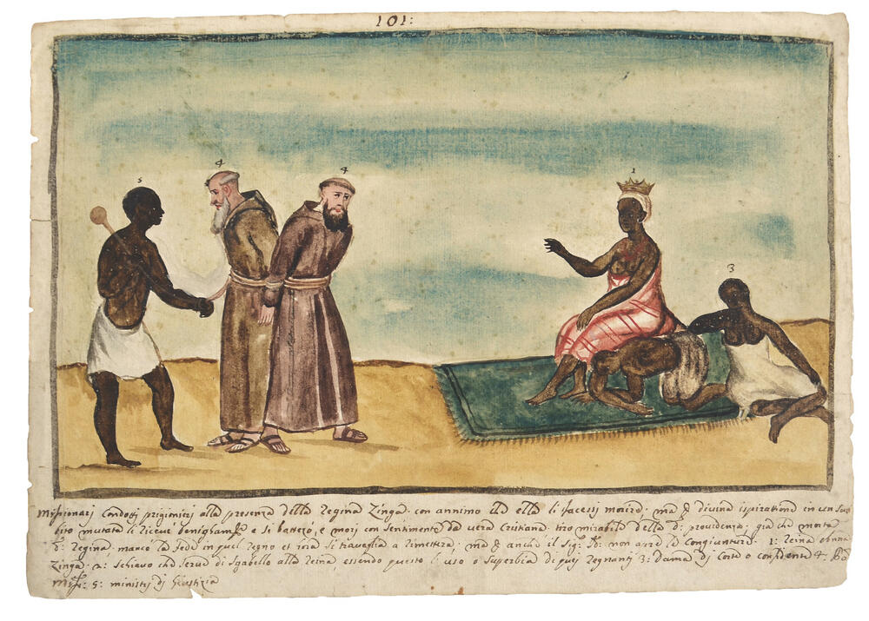
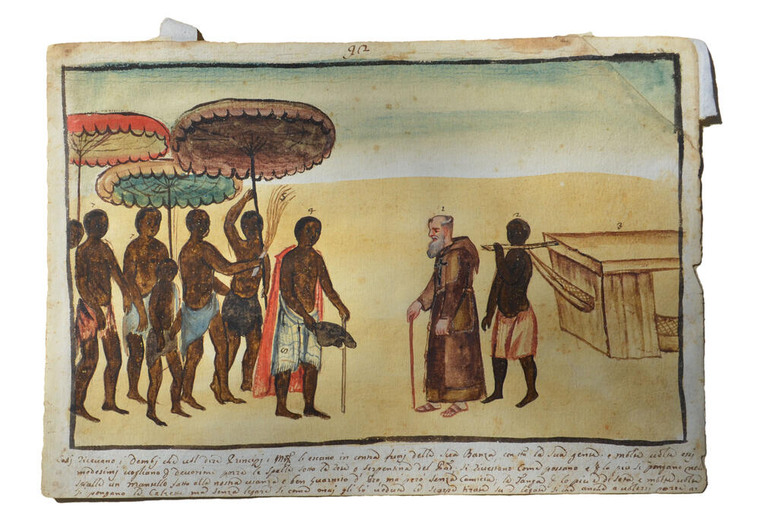
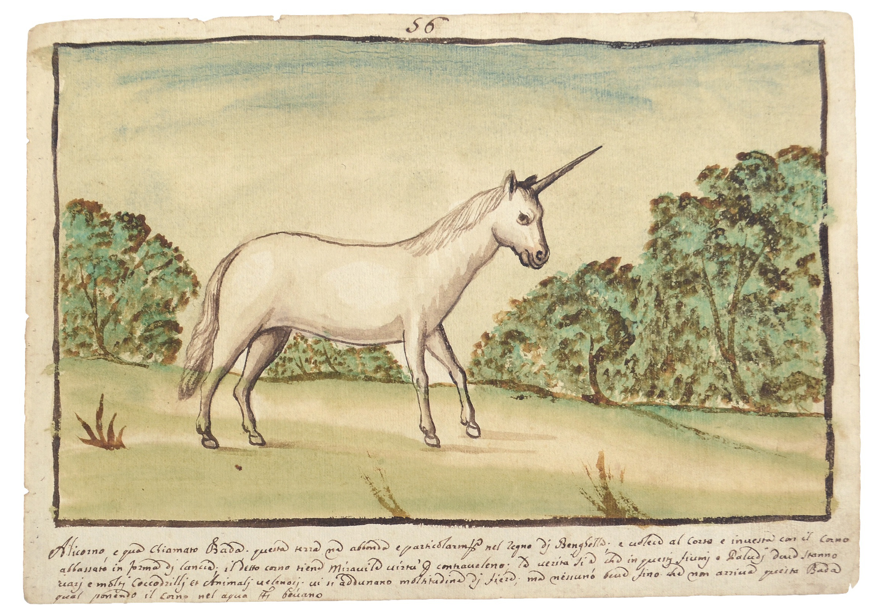
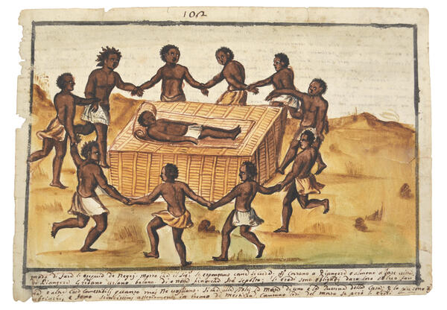
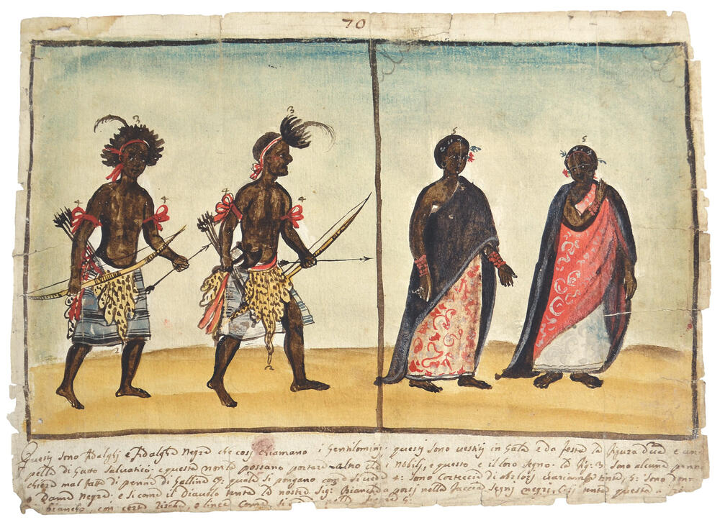
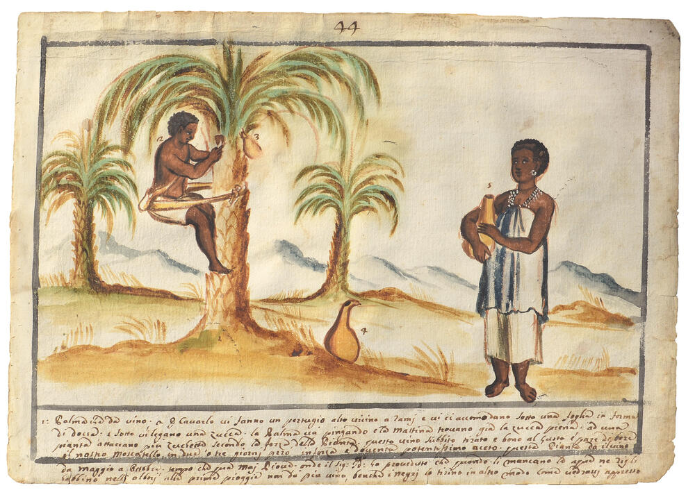
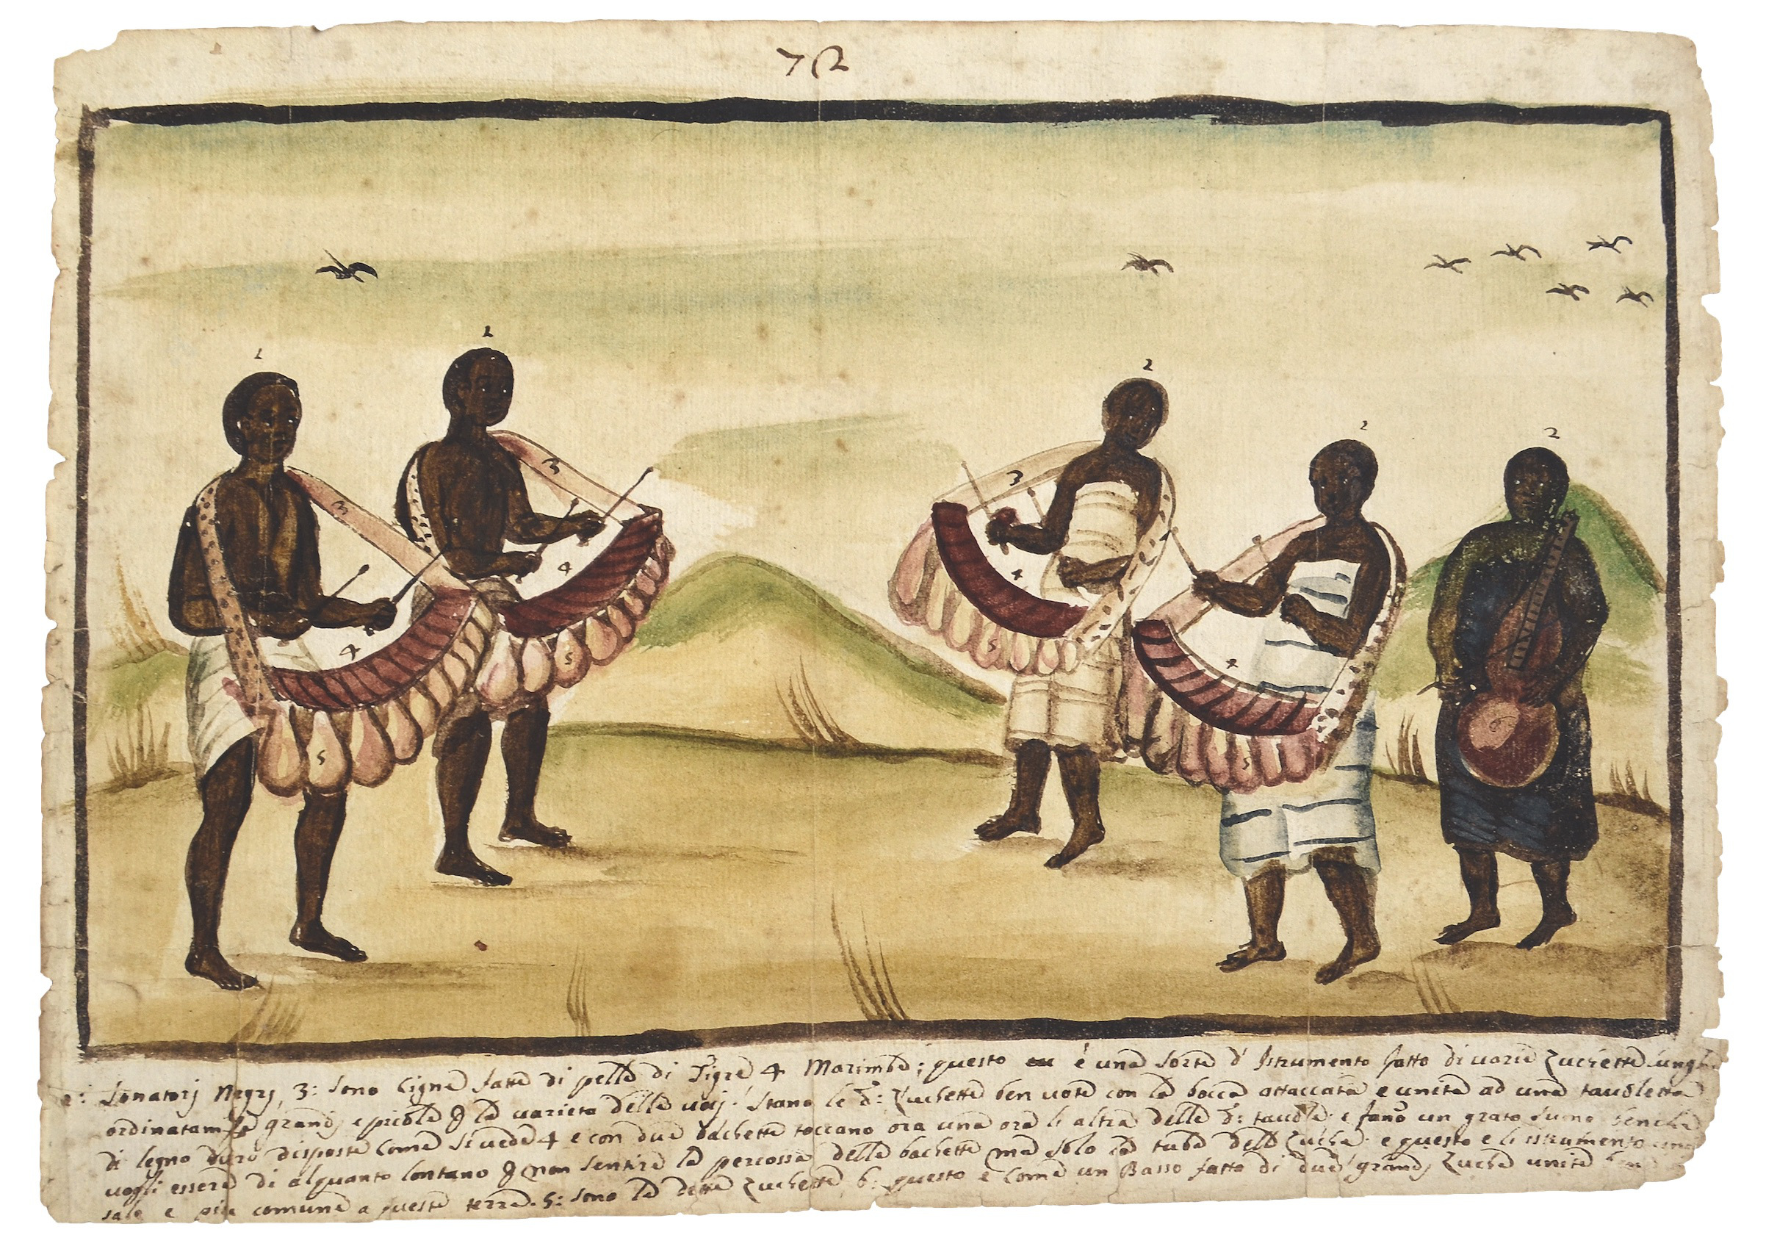
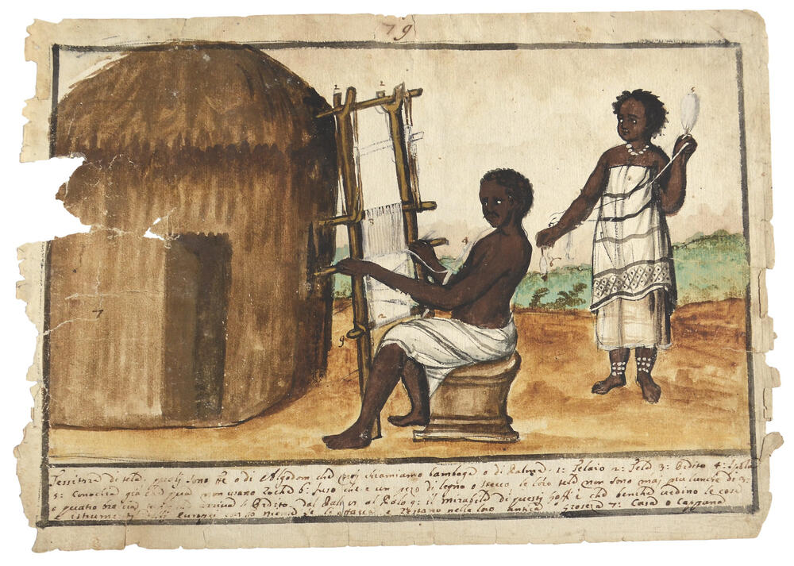

Slide 25
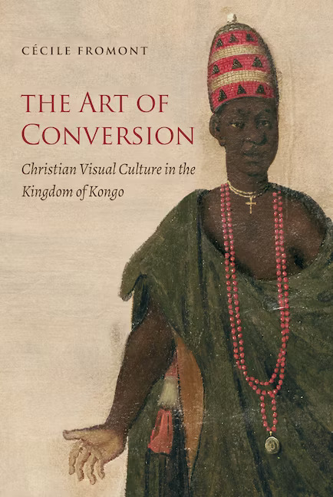
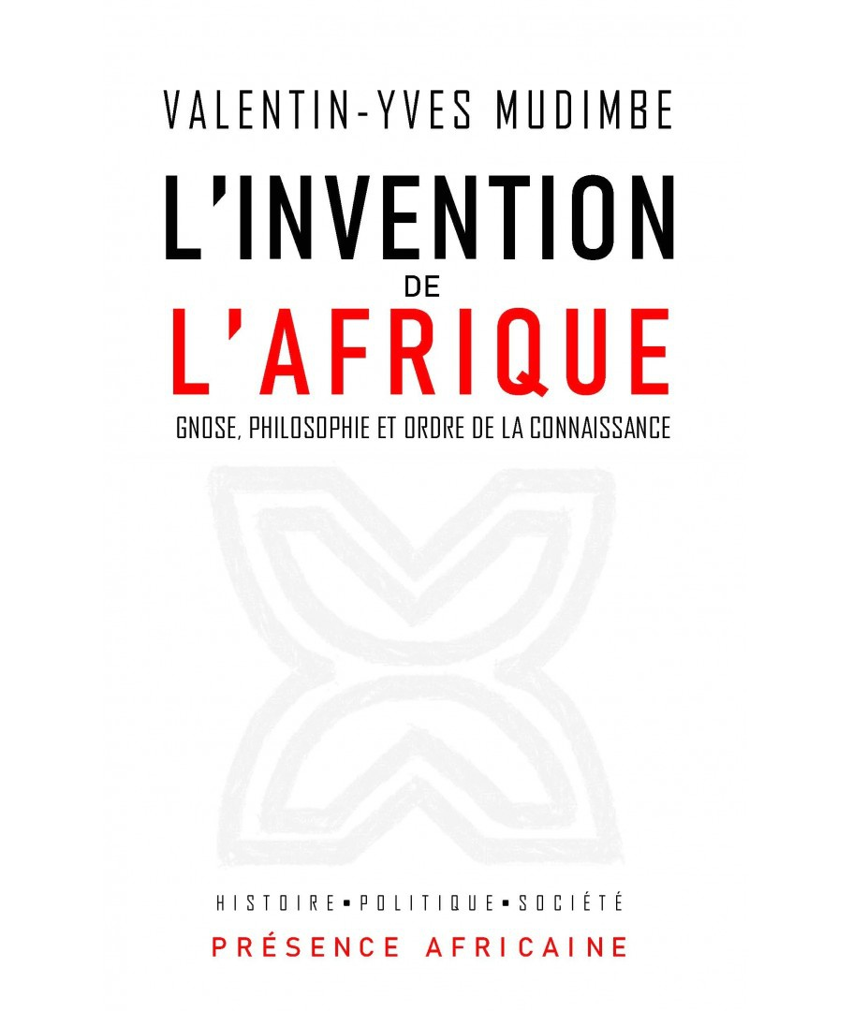
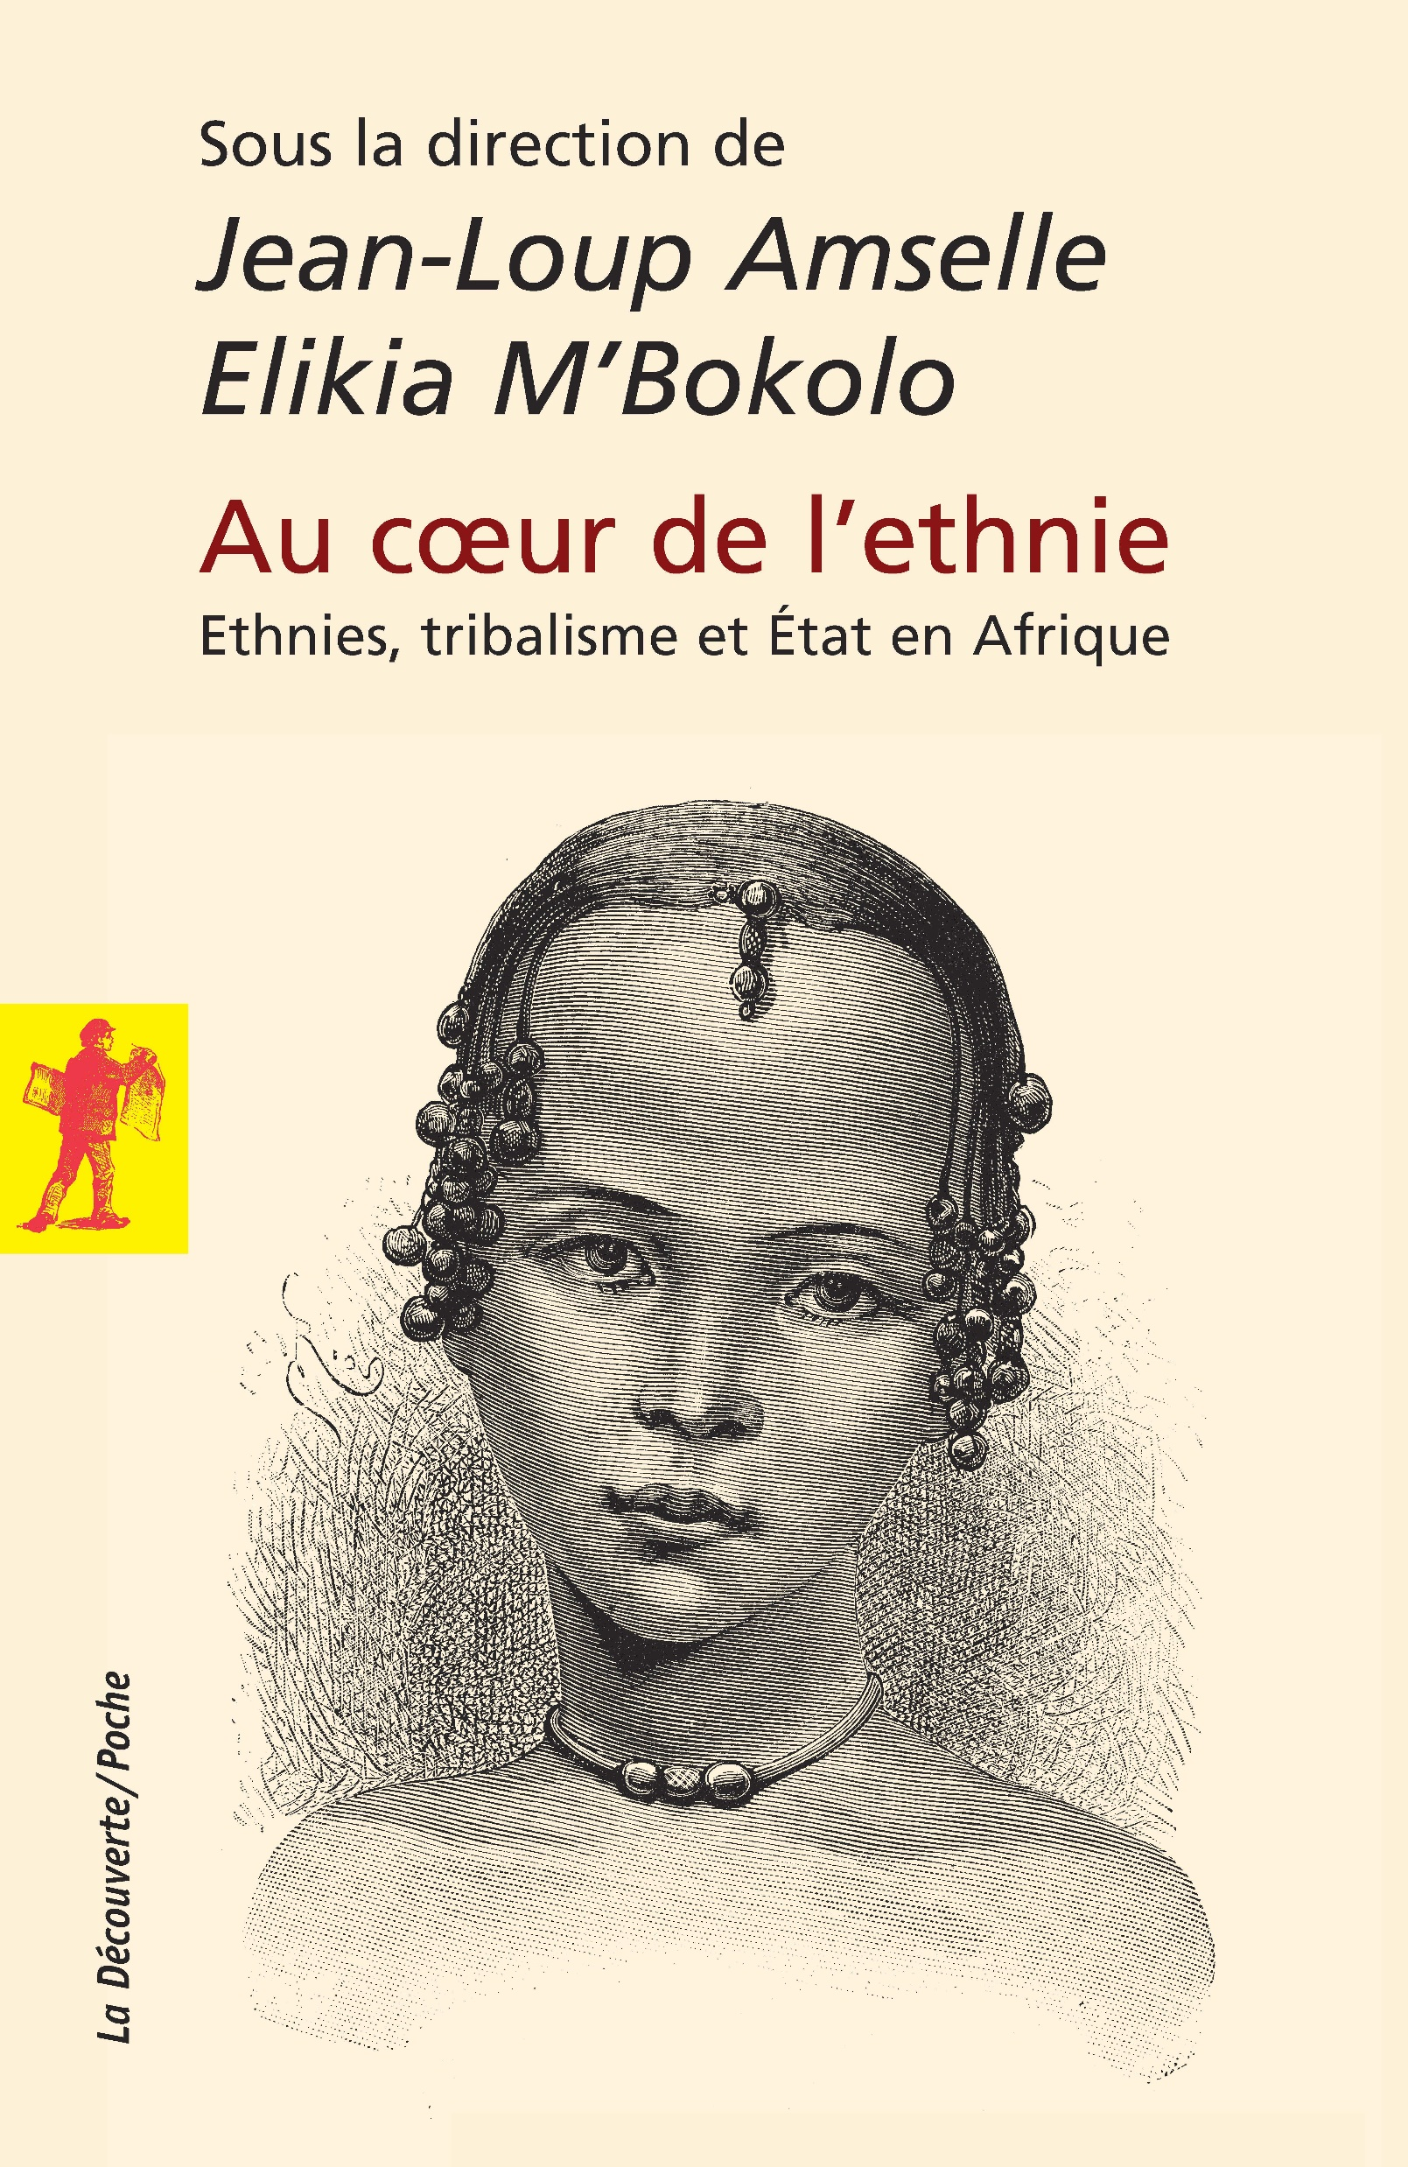
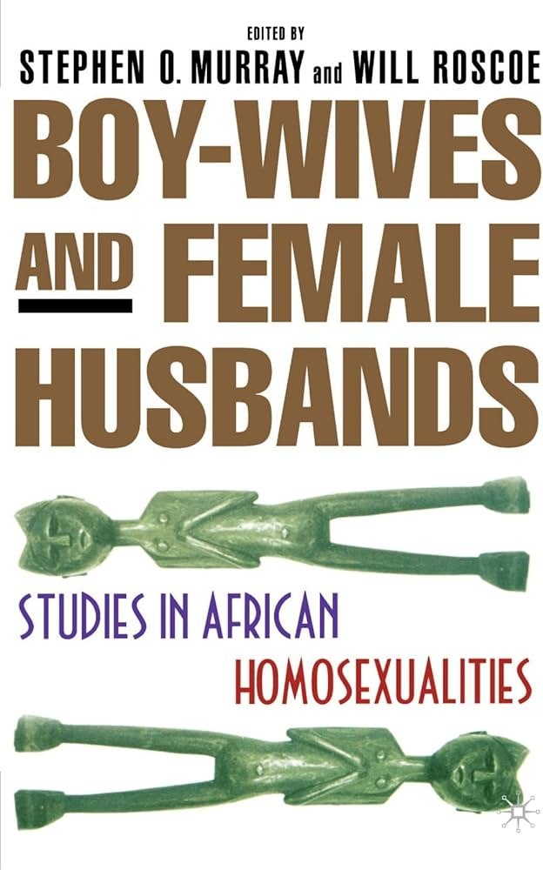
Discarding false dichotomies
A common fallacy tends to oppose ideas like Africa-Europe, modernity-tradition, coloniser-indigenous as binary oppositions when African history itself shows us how these realities are intertwined.
These concepts need to be systematically deconstructed and recontextualised. Our contemporary conceptions of race, identity, ethnicity are all recent constructs, and would have meant very different things to Africans of the past.
Examples of early Euro-African communities, gun warfare.
Transcribing that complexity is one of the cores of academic work.

Slide 26
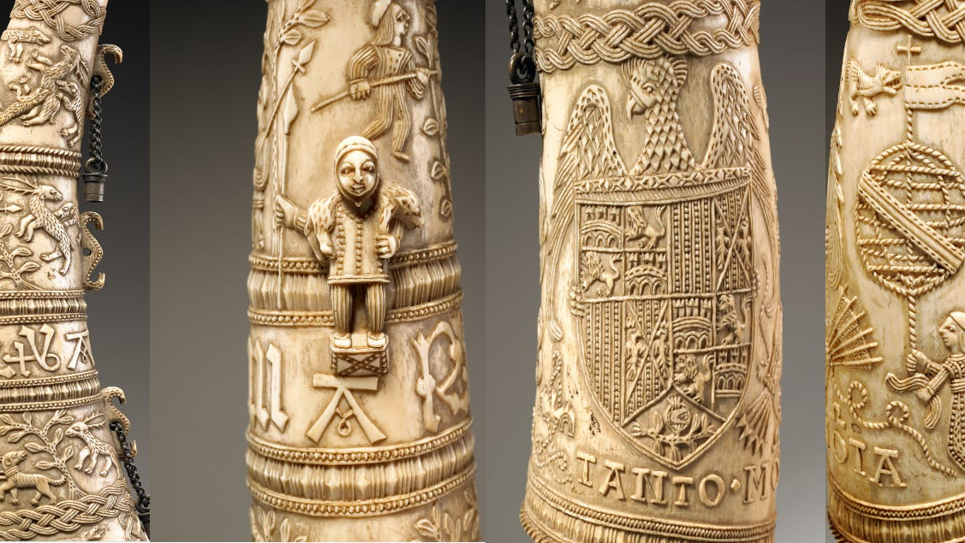

Slide 27
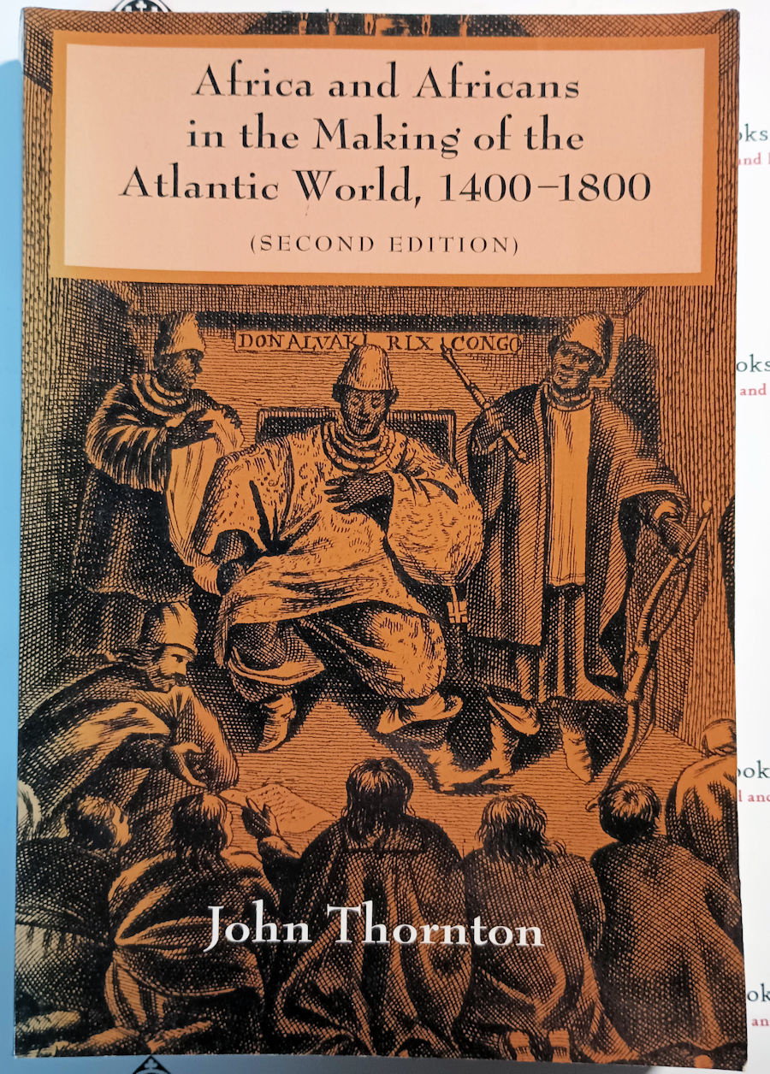
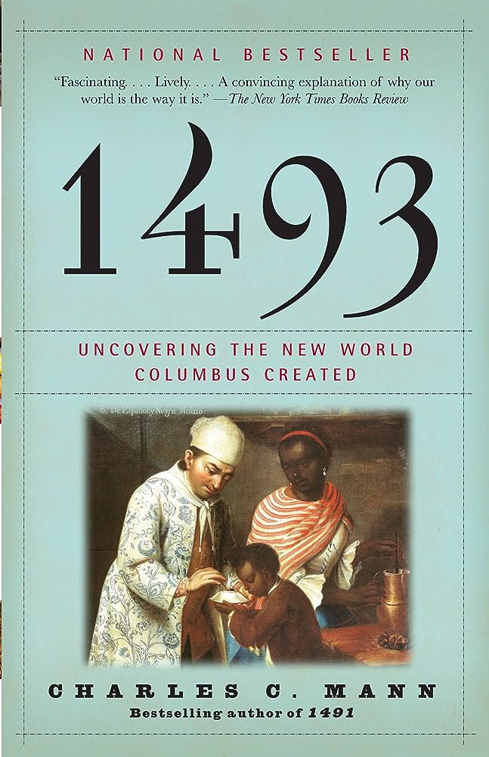
Reconnecting Africa
The African continent wasn't isolated.
Both materially and intellectually, Africa widely exchanged with Asia through the Indian ocean world system, with Europe through the Mediterranean and later with the Americas through the Atlantic.
These exchanges sometimes had dramatic ripple effects, like for example the Columbian Exchange.
Taking stock of it can lead to a better appreciation of Africa’s and Africans’ place in the world, but also of what makes the continent unique.

Slide 28
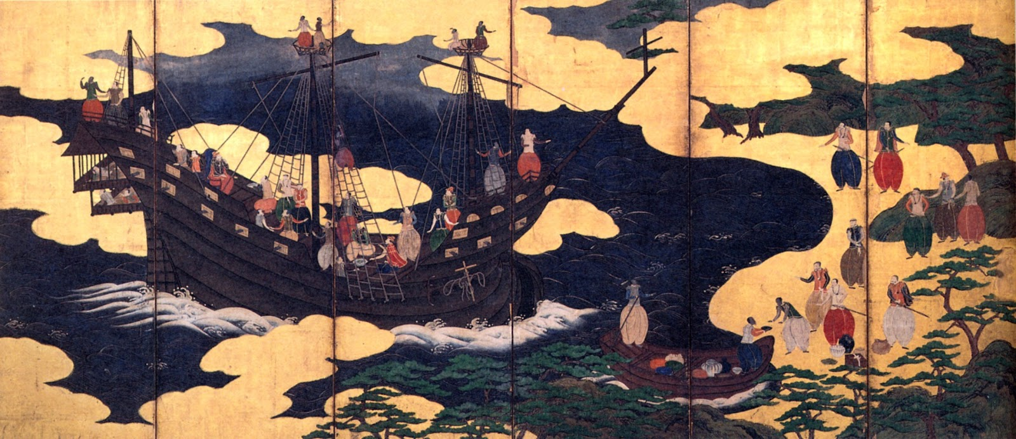

Slide 29
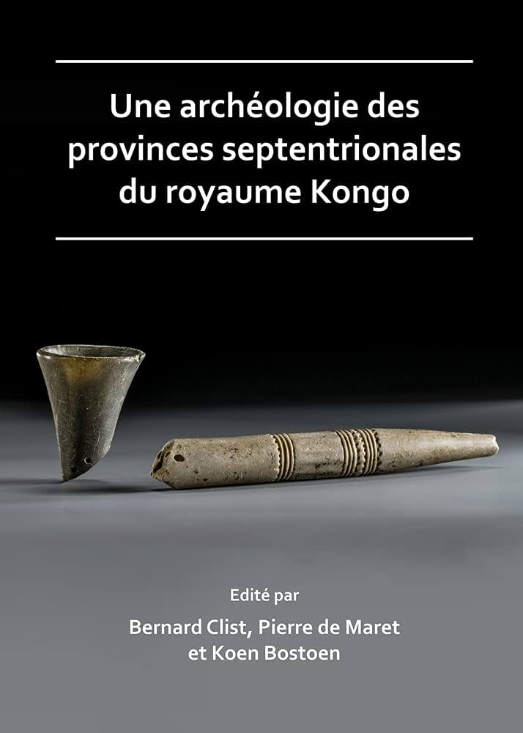
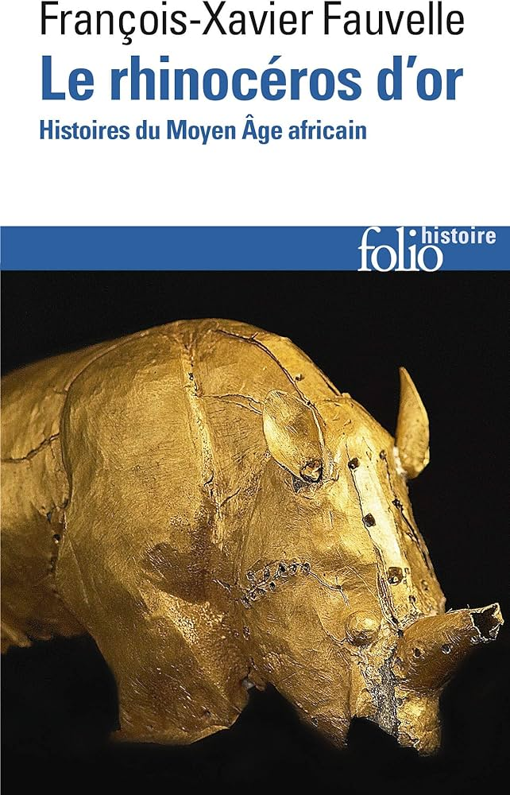
Interdisciplinarity is the key
Though overstated, the rarity of sources is a reality in many regions of Africa.
This can be mitigated by cooperating across fields. In African studies, synergies between Anthropology, History, Archeology... have always been fruitful.
In areas where doing research long proved difficult, new technologies (from genomics to satellite imagery) can help overcome methodological limitations.
Interdisciplinarity isn’t a panacea though, as all of these disciplines have their own colonial baggage.

Slide 30
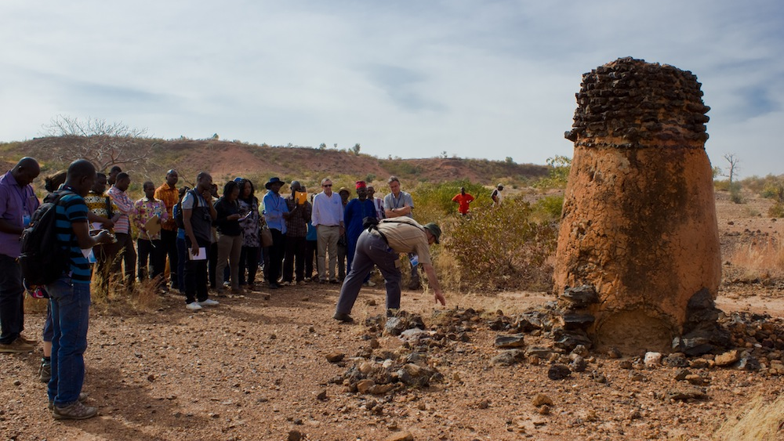

Slide 31
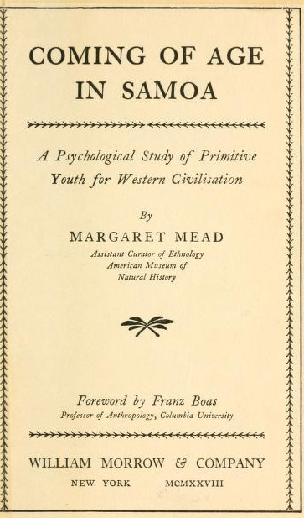
Will methods save you?
Methods aren’t always neutral.
However, a solid methodology is always a plus. Being transparent about it can also help the reader identify biases and shortcomings without diminishing the validity of your work.
Controversy about Coming of Age in Samoa, the 1928 book by star anthropologist Margaret Mead under the supervision of Franz Boas. Mead’s racist biases exposed by the quality of her own fieldwork.
Do not be afraid to take some inspiration from decolonial methodologies.

Slide 32
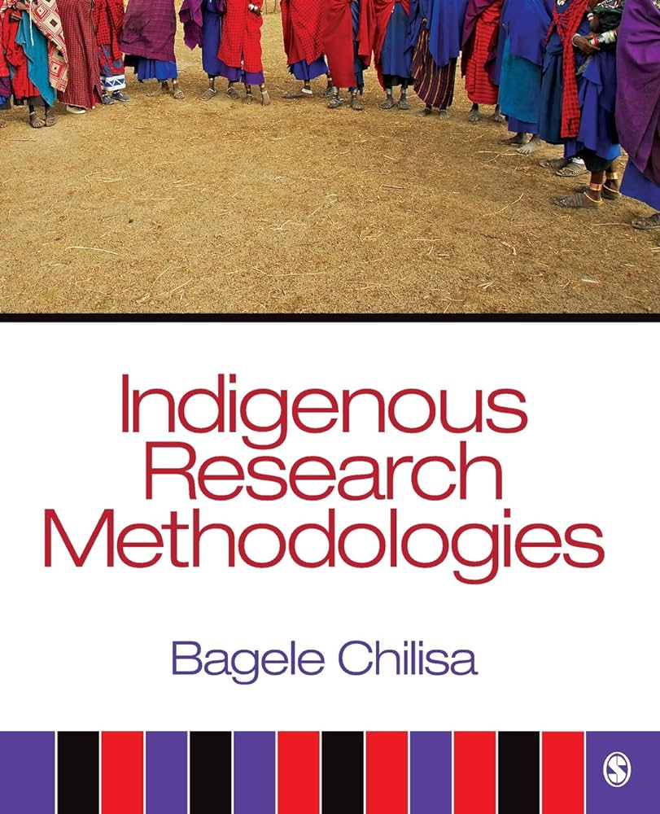
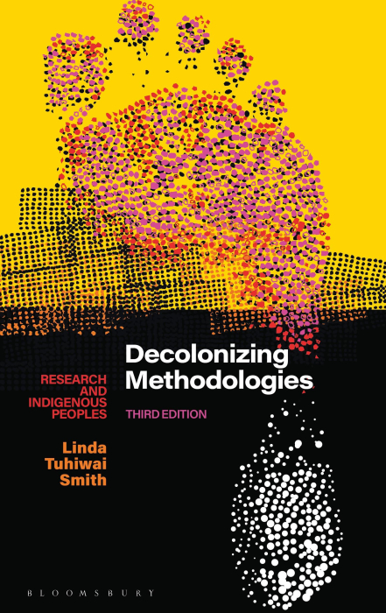

Slide 33
The colonial horizon
The best assets African studies can count on is Africans themselves.
However, despite their intimate insights, linguistic advantages and relative lack of bias, Africans are a proportionally underrepresented in the field.
Most institutions and funding remain located in First World countries. They are sometimes they direct successors of colonial institutes.
As a direct result of colonisation, African states have lower state capacity and budgets. African scholars who can secure funding often do so through European or North American institutions.
Still not all bleak: some prominent African studies centres on the continent in Ghana, Ethiopia, Nigeria, South Africa... and UNESCO-funded projects.

Slide 34
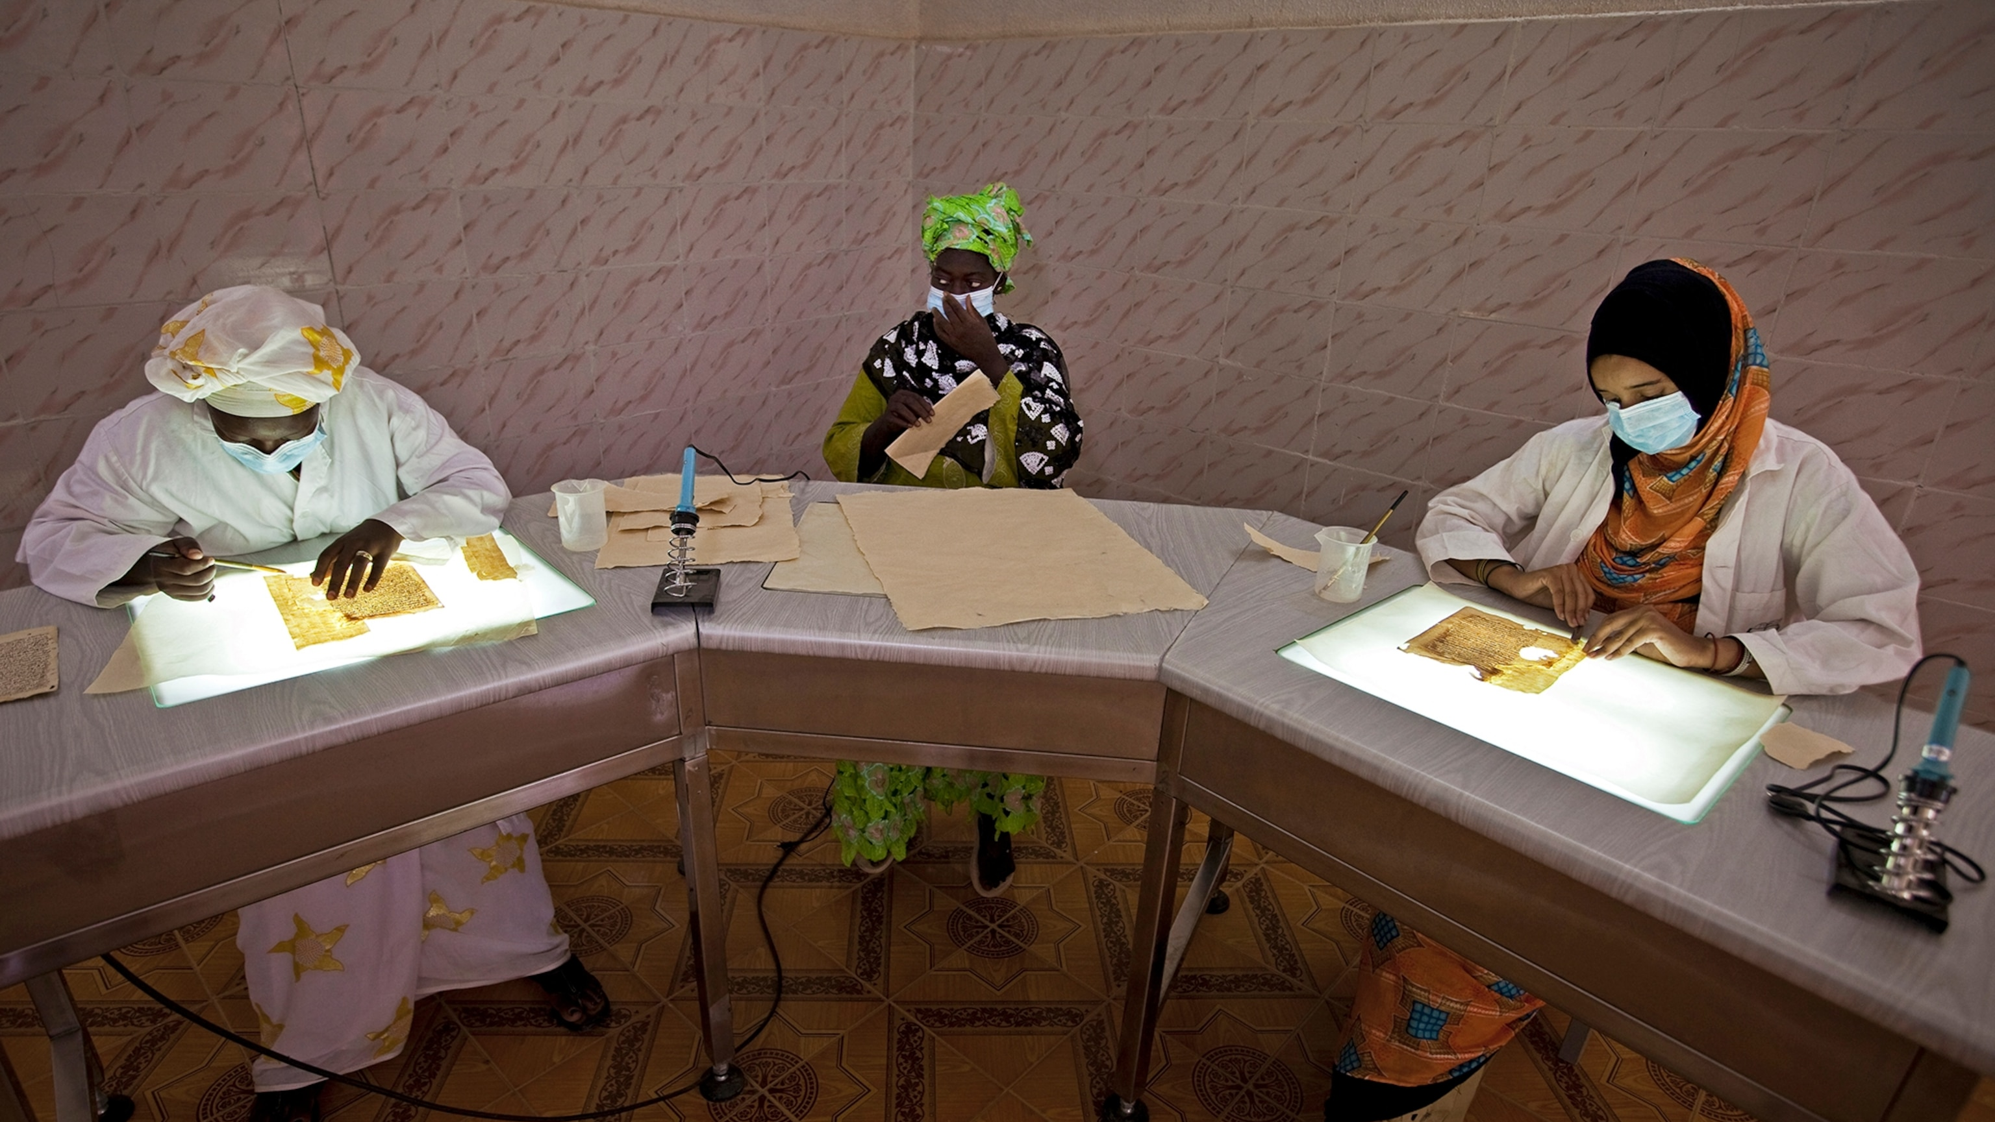

Slide 35
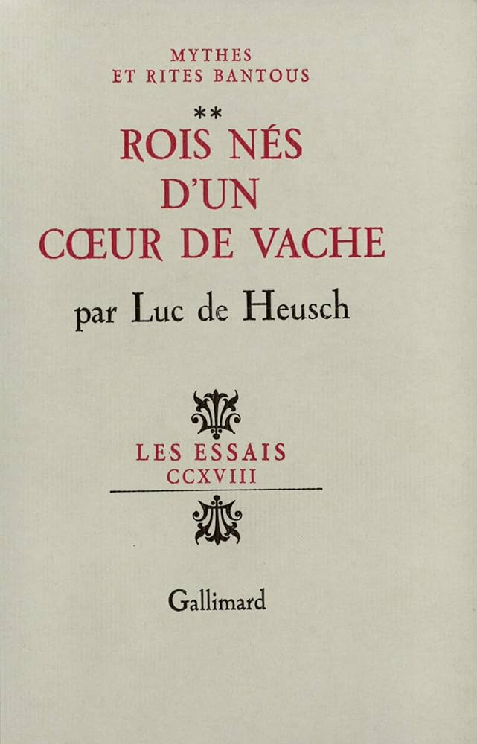
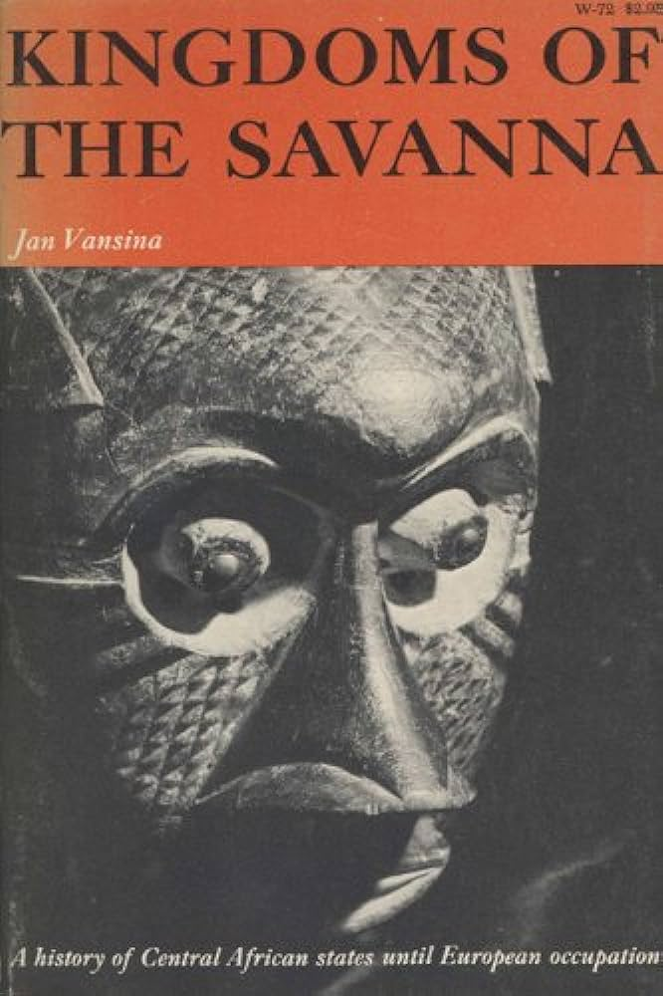
The baby and the bathwater
What to do with the "colonial canon"?
Unfortunately, not as simple as throwing it all away.
In some accounts, in between the racism, you can still find some very valuable information.
Imperfect scholarship doesn't always negate the importance of some scholars' contribution, i.e. Marcel Griaule and Michel Leiris.
Among the hacks, you also find high-level work (De Heusch, Vansina) and legitimate passion (Torday, Cornevin).
Again, methods are often what makes the difference.

Slide 36
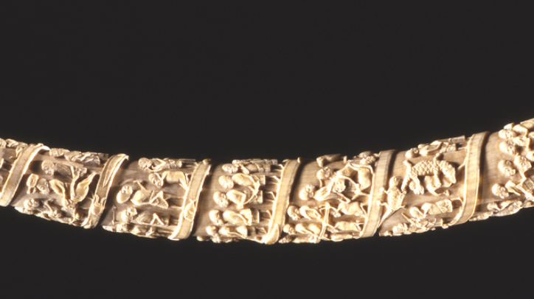
Conclusions
A rotten canon with some of it worth preserving
Dynamic and serious current scholarship
Opportunities for betterment
Limitations remain
Thank you for your attention

