Slide 1
KULT8850/8851
Method, objectivity, and demarcation
(Through the lens of some positions and issues in classical philosophy of science)
Jonathan Knowles
Department of Philosophy and Religious Studies
February 2024

Slide 2
(Some of) the classical questions of philosophy of science
What is ‘science’, or ‘a science’?
What is scientific method and why is it successful (to the extent it is)? Is there a unique, overarching ‘scientific method’?
Does science aim to give us truth/knowledge of reality, or is it primarily just a useful tool for prediction and control?
What does it mean for science to make progress?
Is social and humanistic research science (like physics, chemistry, biology etc.)? If it isn’t, what is it, and why is it worth doing?
To what extent can or should science or scientists tell us how to live? Is science always a force for the good? To what extent are other traditions of knowledge valuable?
Notes:
Pkt 1: What are the necessary and sufficient conditions for an inquiry to be a scientific one? Are tthere such?
Pkt 2:

Slide 3
Outline of session
Part 1: Objectivity (Gaukroger)
Part 2: Philosophy of natural science: Logical positivism, Popper, Kuhn (+ further developments)
Part 3: Philosophy of humanities and social science: Gadamer, Harding (Foucault)
Group discussions along the way
Notes:
Which of these ideas can you make use of?

Slide 4

PART 1:
Objectivity: What is it? Is it possible to achieve? Should we seek it?
The ‘common sense’ view (A. Chalmers What is this thing call science?’ 3rd ed, p. 4): Mind-independent facts are given to us through careful, unprejudiced observation, constituting an independent and reliable foundation for theoretical knowledge about same mind-independent reality.
If this ideal is rejected – do all claims to ‘objective’ knowledge or ‘truth’ become veiled attempts to establish or cement a position of power? What intermediate positions are possible?
objectivism <-------> constructivism.
Notes:
Objectivity: a uniquely human characteristic. One way of thinking about the value and nature of science. Is that why science is good, because it is objective in a special way? Or not?

Slide 5

Different senses of objectivity (Gaukroger)
Sense 1: An objective theory (or view) is one free from bias and prejudice
Sense 2: An objective theory is one free of all assumptions and values
Sense 3: An objective theory is one formed in accord with a certain method that can decide between conflicting views
Sense 4: An objective theory is one that accurately represents reality
Sense 5: An objective theory is one that is universally accepted
(Are there more senses?)
Notes:
Graukoger concerned with everyday matters as well as research but also research.
Some of these senses are definitions, some more plausibly necessary conditions (3 and 5), according to him (though the import of this is not totally clear).
3 connectted to science but not just science (also political philosophy).
Sense 4: often seen as an ideal from enlightenment. Truth as accurate representation of mind-independent reality. Can a theory be objective wihout being this? Intuitively yes for objective views allow mistakes. But is it necessary that one is at least aiming to mirror reality as it is in itself to be objective? Is objectivitiy in this sense a good thing, always?

Slide 6
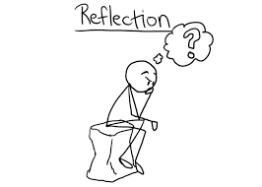
How important is objectivity in your research?
What kind of objectivity is at stake?
Is it on Gaukroger’s list or something different from these?
Is objectivity possible or desirable in research (or more generally)?

Slide 7

PART 2:
Philosophy of Natural Science

Slide 8
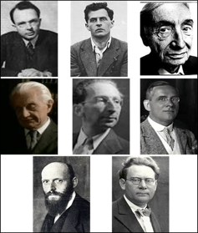
Logical Positivism
Science and rational belief coextensive.
Unity of science: All rational beliefs (i.e. all science) can be incorporated into one overarching system.
The principle of verification: All meaningful statements must be possible to verify, in principle (i.e. be such that one can determine whether they are true or not through observation).
Notes:
Rejection of metaphysics: All other statements are either (logical consequences of) definitions or meaningless.
Ethics expressivist.
Observation statements grounded in pure sensation. (Perhaps…)
Scientific reasoning to be understood in terms of inductive logic/probability.
Moved towards forms of conventionalism and anti-realism.
Non-synthetic statements are either meaningless or reflect the medium of representation.
Last point: Carnap: science and semantics need to be given free reign to try out different frameworks but these do not involve claims about the way the world is in itself.

Slide 9
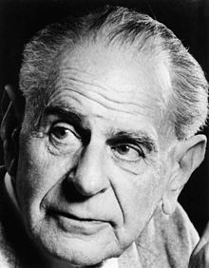
Karl Popper (1902-1994)
Best known works: The Logic of Scientific Discovery (1936), The Open Society and Its Enemies (1945).
In 1992 awarded Kyoto Prize in Arts and Philosophy for “symbolizing the open spirit of the 20th century” and for “enormous influence on the formation of the modern intellectual climate”.

Slide 10

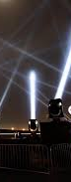
The Bucket versus
The Searchlight
The Bucket Theory
Sense experiences prior to any knowledge
Knowledge consists in the sum of your experiences, the more experiences you accumulate, the more knowledge you have
The Searchlight Theory
Observations secondary to hypotheses
‘An observation is a perception, but one which is planned and prepared’ (Popper 1972: 342)
Observations serve as tests of the hypothesis
Knowledge as ‘horizon of expectations’

Slide 11
Popper on scientific method
Rejects induction as rational inference (cf. Hume) and as method used in actual science (or everyday experience), cf. ‘bucket theory’.
’Searchlight theory’: organisms always already understand their environment in relation to a horizon of expectations. Theory precedes observation.
‘Science’ per se started with conscious critical appraisal of inherited mythical and then more naturalistic explanations in the Ionian school of philosophy.
  Theories critically assessed by being tested against (theory-laden) observational data.
  Scientific testing, explanation, prediction and application all have same hypothetico-deductive structure and involve laws.
Notes:
There was ‘scientific’ or mathemtical thoguth beefore Thales eg Pythagaros
Problems can be theoretical or theoretical/observational, or perhaps practical.
(Scientific) explanation is not ‘reducing the unknown to the known’, but finding a new theoretical framework to understand both what is observed and more.

Slide 12
Popper on scientific method (contd.)
A confirmation does not prove a law or even make it probable. (Though we are rational to accept claims that have been subjected to (many) severe tests and withstood them, these are (highly) corroborated.)
Science makes progress through falsifying existing theories and replacing them with others that avoid the counterexample and explain more phenomena (in part by being more general, more precise, more quantitative etc.).
Notes:
‘Severe test’ one indvolving independently unexpected prediction of law turns out true
Falsifiability is in index of explanatory strength: the more general and precise a theory, the more it prohibits. Scientific progress involves a series of gradually more and more falsifiable theories (Galileo -> Newton -> Einstein).
One can think of how science operates by thinking of its theories as prohibitions of particular circumstances and trying to find out if these hold or not.

Slide 13
Falsifiability as demarcation principle
Scientific claims must be falsifiable (rather than verifiable):
  “Every ’good’ scientific theory is a prohibition: it forbids certain things to happen. The more a theory forbids, the better it is…A theory which is not refutable by any conceivable event is non-scientific. Irrefutability is not a virtue of a theory (as people often think) but a vice.” (Conjectures and Refutations, 1962, p. 46; cp. B&S, p. 360)
Irrefutable theories are pseudo-scientific. Examples for Popper: psychoanalysis (Freud, Adler), dialetical materialism (Marx).
Notes:
[Why exactly is being unable to refute a theory a reason to be suspicious of it?]
Unfalsifiable theories also fail to explain; explanation is contrastive: this happened rather tthan that....
History and many other humanities/social studies are not science in this sense: they may be hypothetial/critical, but their hypotheses typically concern particular conditions that are subsumed by laws that are obvious or taken for granted.

Slide 14
Summa summarum
“[T]he aim of the scientist is not to discover absolute certainty, but to discover better and better theories [or to invent more and more powerful searchlights] capable of being put to more and more severe tests [and thereby leading us to, and illuminating for us, ever new experiences]. But this means that these theories must be falsifiable: it is through their falsification that science progresses.” (B&S, p. 361).

Slide 15
Problems/challenges for Popper
Popper thinks of himself as a scientific realist, but in fact it seems we have no reason on his view to think our best theories are true, approximately true or even (in spite of what he claimed) truer than what has gone before.
Since predictions are derived from many assumptions, we cannot know what is mistaken if our prediction is falsified. It can seem, moreover, that Popper’s strongly anti-inductivist philosophy gives us no way to make even a rational choice here.
His recommendation of a critical attitude is not adhered to in many episodes of science, from Galileo to Darwin.
Is his picture of science outdated in light of more recent developments?
Notes:
We are neverthless subject to confirmation bias so improtant to stress falsification. Used in police work. Popper

Slide 16
Example from Lakatos (cf. Knowles ch. 4, p. 78)
«A physicist...takes Newton’s mechanics and his law of gravitation, (N), the accepted initial conditions, I, and calculates, with their help, the path of a newly discovered small planet, p. But the planet deviates from the calculated path. Does our Newtonian physicist consider that the deviation [...] refutes the theory N? No. He suggests that there must be a hitherto unknown planet p’ which perturbs the path of p. He calculates the mass, orbit, etc., of this hypothetical planet and then asks an experimental astronomer to test his hypothesis....But [the new planet is not where it should be]. Does our scientist abandon Newton’s theory [...]? No. He suggests that a cloud of cosmic dust hides the planet from us. He calculates the location and properties of this cloud [and sends up a satellite to investigate]. But the cloud is not found. Does our scientist abandon Newton’s theory[...]? No. He suggests that there is some magnetic field in that region of the universe which disturbed the instruments of the satellite [and so on and so forth].»

Slide 17
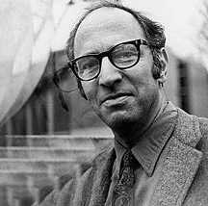
Thomas Kuhn (1922-1996)
Historian and philosopher of science.
Most famous book: The Structure of Scientific Revolutions, 1962/1970.
Presents an empirical account of the the historical development of natural science (mainly physics and chemistry) and introduces various concepts to explain and understand this (in his view) progressive enterprise.
Notes:
Kuhn never queetions that science is a good thing, so his view of science is also that of the scientists.
Gist: We need more focus on how science actually develops, how science and scientists actually work and think, rather than on formal principles of rationality. (Though his theory is not meant to be without normative implications.)
Some of what Kuhn says can seem to cast doubt on the idea of science as a (purely) rational endeavor, but that is not his intention. Kuhn does deny science is capable of giving us ‘The Truth’ about the natural world, but insists that it has increased in its problem-solving capacity over time.

Slide 18
Outline and key concepts
Prescience ->
Normal science (steered by paradigm) ->
Crisis (anomalies numerous and solution-resistant) –>
Revolution ->
New Normal Science –>
(And so on...).
Different paradigms are incommensurable.

Slide 19
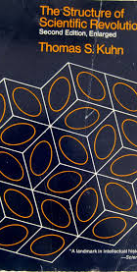
Postscript definition of paradigm (1970)
Paradigm as disciplinary matrix (p. 181).
  Symbolic generalizations: laws/definitions
  Metaphysical assumptions: models, metaphors.
  Values: epistemic virtues a theory should fulfill, e.g. internal and external consistency, predictive accuracy, simplicity etc.
  Exemplars: concrete episodes of research that serve as standards or ’paradigms’ for further research
Notes:
Symbolic generalizations: Newton’s laws of motion/force.
Models/metaphysical assumptions: universe infinitely extended in 3D space and (independently) time, physical quantities (motion, size, mass etc.) absolute in relation to this framework
Values: Predictive accuracy, consistency, simplicity, quantitative formulability etc.
Exemplars: Concrete application of laws of motion to predict movements of moon and planets, to tidal phenomena, rotating objects on earth etc.
Involves thinking of paradigm as involving in part tacit knowhow.
Laws can be empirical generalisations but can also be definittions of central ideas. Eg f = m.a.
Not all but many values are shareed accross paradigms. Values don’t give an algorithm for decision in any case.
Knowledge of exemplars is a kind of non-explicit, tacit knowledge that fleshes out the theoretical knowledge, gives it content. Has quite far-reaching consequences eg that the world a scientist deals with, sees is partly a product of a kind o way of seeing or skill. Kuhn trieed to understand this scientifically, it is not some kind of occult knowledge

Slide 20
Normal science
“Normal science, the puzzle-solving activity we have […] examined, is a highly cumulative enterprise, eminently successful in its aim, the steady extension of the scope and precision of scientific knowledge. […] Yet one standard product of the scientific enterprise is missing. Normal science does not aim at novelties of fact or theory and, when successful, finds none.” (Kuhn 1970: 52).
“Mopping-up operations are what engage most scientists throughout their careers” (Kuhn 1970: 24).
Notes:
Exemplars steer but not as explicit rules do

Slide 21
Crises and revolutions
‘All crises begin with the blurring of a paradigm and the consequent loosening of the rules for normal research. .. a crisis may end with the emergence of a new candidate for paradigm and with the ensuing battle over its acceptance.’ (Kuhn 1970: 84).
‘The decision to reject one paradigm is always simultaneously the decision to accept another, and the judgment leading to that decision involves the comparison of both paradigms with nature and with each other.’ (Ibid.: 77)
‘Once a first paradigm through which to view nature has been found, there is no such thing as research in the absence of any paradigm. To reject one paradigm without simultaneously substituting another is to reject science itself.’ (Ibid.: 79).

Slide 22
Incommensurability
No paradigm-external decision procedure for adjudicating between different paradigms. Some general criteria are shared (simplicity, consistency, precision etc.), but will be interpreted differently.
Concepts differ in spite of superficial similarity (e.g. ‘movement’, ‘mass’, ‘element’, ‘planet’)
No theory-neutral observations, practitioners of different paradigms see the world differently.
Notes:
Pkt 2 Follows both from his semantic theory and the role exemplars play in research.

Slide 23
Revolutions as arational
‘As in political revolutions, so in paradigm choice – there is no standard higher than the assent of the relevant community. To discover how scientific revolutions are effected, we shall therefore have to examine not only the impact of nature and of logic, but also the techniques of persuasive argumentation effective within the quite special groups that constitute the community of scientists [..the] issue of paradigm choice can never be unequivocally settled by logic and experiment alone.’ (SSR, 93)

Slide 24
World changes
‘[A]t times of revolution, when the normal-scientific tradition changes, the scientist’s perception of his environment must be re-educated – in some familiar situations he must learn to see a new gestalt. After he has done so the world of his research will seem, here and there, incommensurable with the one he had inhabited before. That is another reason why schools guided by different paradigms are always slightly at cross-purposes’ (Kuhn 1970: 111).
‘[A]fter a revolution, scientists work in a different world’ (ibid.: 134).

Slide 25
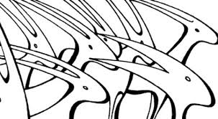
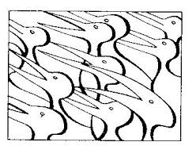
Gestalt psychology

Slide 26
Progress for Kuhn
Kuhn later described his position as a form of ‘post-Darwinian Kantianism’.
The ‘reality’ of scientists is dependent on the paradigm they accept, but is not just something mental.
Paradigms become gradually better at solving problems.
Progress is not convergence on ‘The Truth’, but more like evolutionary progress: progress relative to a given starting point and a changing environment.
Notes:
Is this graudualsit picture in accord with earlier one of paradigms as discrete? If so, can we make sense of paradigms bcoming betteer

Slide 27
Reactions to/questions for Kuhn
Popper: pitied ‘normal scientists’, regarding them as mere ‘engineers’. He also doubted the generality of a sharp distinction between normal and revolutionary science. Paradigms can also seemingly compete and exist concurrently over time (e.g. wave and particle theory of light), cf. Lakatos on research programmes.
Kuhn’s work focussed on physics and chemistry, not so clear how it applies to other areas, eg biology.
Is much contemporary science really so paradigm-driven, rather than data-driven?
Do we really see the world differently today than someone in the Middle Ages? Do Kuhn’s arguments really suggest science can’t give us objective knowledge, or approximation thereto?
Kuhn’s concepts of paradigm, normal science, values, progress etc. arguably provide no normatively significant science/non-science divide (Feyerabend.)
Notes:
(Popper pitied ‘normal scientists’, regarding them as mere ‘engineers’. But normal science can be seen as exploratorily, if not transformationally creative, cf. Margaret Boden 1991.)

Slide 28
Developments after Kuhn
Imré Lakatos tried to steer a middle course between Popper and Kuhn. Theories are complex wholes but can be rationally compared.
Paul Feyerabend suggested science does not deserve the elevated status it is usually afforded. There is no ‘scientific method’.
Cf. also ‘sociology of scientific knowledge’/science and technology studies (and ‘science wars’ of late. 1990s).
Notes:
Today, the ideal of ‘value-free’ science is often rejected, though not all see this as a reason to reject the idea that scientific knowledge should still have priority.

Slide 29
Developments after Kuhn contd.
Contemporary analytic philosophers of science tend to be more ‘positivistic’ than Popperian, and more naturalistic than both.
  Some lay stress on confirmation and probability through Bayesian calculus (cf. e.g. Deborah Mayo).
  Some think it is vital to properly understand science that we take account of the way our language and practices as enmeshed in the real, causal order. A view of science as building on sense data and having a purely logico-linguistic structure leads to scepticism, relativism etc.
  Some think that philosophy of science beyond general epistemology is largely dead and should be replaced by various philosophies of the different special sciences.
  The idea of falsifiability remains intuitively important for most philosophers. Most want to preserve some kind of objectivity in science at the same time as acknowledging its value-ladenness. Realism versus anti-realism still a central issue.

Slide 30
How important are the ideas of falsifiability and/or a paradigm in your research?

Slide 31

PART THREE
PHILOSOPHY OF HUMANITIES AND SOCIAL SCIENCES
Notes:
All three of the thinkers we shall look at here represent a kind of critique of modernism, or scientism, either as deeply misguided, or as contingent, or as insufficient to tackle problems of today. They can also be seen as thereby arguing for a distinctive role for humanities and/or social science other than just a kind of science (or else a kind of ethical watch dog, cf May Thorseths lectures.)

Slide 32
Hans Georg Gadamer: ‘The Universality of the Hermeneutical Problem’ (1966)
Notes:
Main book: Truth and Method (Wahrheit und Metode). In this he argues that hermeneutics is not a method but our fundamental way of ‘being in the world’. He is a kind of romantic in the sense that opposed enlighttenment thinking, that tradition and belonging are essential to us. Science and technology are ailenating. He has been criticized by critical theorists like Haberemas for being too concerned with tradition and with not taking on board the perspective of emancipatory projects. We won’t be looking at that but will look at Harding as a feminist critical theorist.

Slide 33
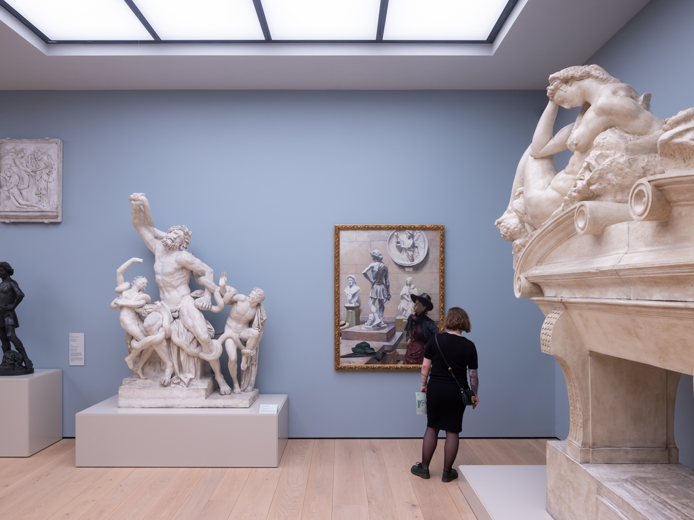
Art

Slide 34
Alienation in ‘the aesthetic consciousness’
‘When we judge a work of art on the basis of its aesthetic quality, something that is really much more familiar to us is alienated.’ (5)
‘No artist of the religiously vital cultures of the past ever produced his work of art with any other intention than that it should be received in terms of what it says and presents and that it should have its place in the world where men live together.’ (4-5)
‘Despite its use by the national socialists, we cannot deny that the idea of art being bound to a people involves a real insight.’ (5)
Notes:
Alienation involves a kind of objectification of something that is essentially familiar.
G came from a background of german philosophers concerned with geisteswissenshaften, what kind of method this involves. And a lot of his thought revolves around the idea of rejecting this idea of what humanities reesearch is, which you also find in othhers like Dewey, Williams. But it’s rather under pressure ttoday becausee of its emphasis on tradition. Mattias will talk more about this tomoorw.

Slide 35
Alienation in ‘the historical consciousness’
‘No one disputes the fact that controlling the prejudices of our own time to such an extent that we do not misunderstand the witnesses of the past is a valid aim, but obviously such control does not completely fulfill the task of understanding the past.’ (6)
‘Misunderstanding and strangeness are not the first factors, so that avoiding misunderstanding can be regarded as the specific task of hermeneutics. Just the reverse is the case. Only the support of the familiar and common understanding makes possible the venture into the alien [...] and thus the broadening and enrichment of our own experience of the world.’ (15)
‘Every misunderstanding presupposes a «deep common accord»’ (7)
‘Whenever we say [...] «this is classical; it will endure» what we are speaking of has already preformed our possibility for aesthetic judgment.’ (8)
‘The great horizon of the past, out of which our culture and our present live, influences us in everything we want, hope for, or fear in the future. History is only present to us in the light of our futurity.’ (8-9)
Notes:
Alienation involves a kind of objectification of something that is essentially familiar.

Slide 36
Prejudice (‘pre-judice’, ‘pre-judgement’). Language
‘Prejudices are not necessarily unjustified and erroneous, so that they inevitably distort the truth. In fact, the historicity of our existence entails that prejudices, in the literal sense of the word, constitute the initial directedness of our whole ability to experience.’ (9)
‘The nature of the hermeneutical experience is not that something is outside and desires admission. Rather we are possessed by something and precisely by means of it we are opened up for the new, the different, the true.’ (9)
‘The consciousness that is effected by history has its fulfillment in what is linguistic. [...L]anguage [...] has a teleology operating in it [...] a definite articulation of the world is built up .. a process one can observe in children who are learning to speak.’ (13)

Slide 37
Critique of scientism/modernism
‘No assertion is possible that cannot be understood as an answer to a question.’ (11)
‘The real power of the hermeneutical consciousness is our ability to see what is questionable.’ (13)
'What is established by statistics seems to be a language of facts, but which questions these facts answer and which facts would begin to speak if other questions were asked are hermeneutical questions.’ (11)
Notes:
Science seen by Gadamer as a kind of technological force out of its (i.e. our) control, at the same time as it allegedly stands for an ideal of unprejudiced objectivity. BUT:

Slide 38
Critique of scientism, modernism contd.
‘We live in an epoch in which an increasing leveling of all life-forms is taking place – that is the rationally necessary requirement for maintaing life on our planet. [...] Unavoidably the mechanical, industrial world is expanding within the life of the individual as a sort of sphere of technical perfection. When we hear modern lovers talk we often wonder if they are communicating with words or with advertising labels and technical terms from the sign language of the modern industrial world.’ (16)
’Genuine speaking, which has something to say and does not give prearranged signals, but rather seeks words through which one reaches the other person is the universal human task – but it is a special task for the theologian, to whom is commissioned the saying-further (Weitersagen) of a message that stands written.’
Notes:
This was written in 1960!!!!

Slide 39
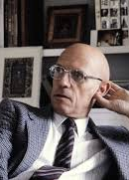
Michel Foucault on truth and power
’Each society has its regime of truth, its “general politics” of truth: that is, the types of discourse which it accepts and makes function as true; the mechanisms and instances which enable one to distinguish true and false statements, the means by which each is sanctioned; the techniques and procedures accorded value in the acquisition of truth; the status of those who are charged with saying what counts as true’ (The Foucault Reader, ed. Rabinow 1991).
“In a sense, I am a moralist, insofar as I believe that one of the tasks, one of the meanings of human existence—the source of human freedom—is never to accept anything as definitive, untouchable, obvious, or immobile. No aspect of reality should be allowed to become a definitive and inhuman law for us. We have to rise up against all forms of power—but not just power in the narrow sense of the word, referring to the power of a government or of one social group over another: these are only a few particular instances of power. Power is anything that tends to render immobile and untouchable those things that are offered to us as real, as true, as good” (Power/Knowledge, ed. Gordon 1980)
Notes:
For Foucault calling something true is the ultimate bluff. At the same time as he is driven by a trruthfulness.

Slide 40
Sandra Harding: ‘Strong objectivity’ and socially situated knowledge (from Whose Science? Whose Knowledge? 1991)

Slide 41
Standpoint theory (SPT) and objectivity
Feminist standpoint theory stands between feminist empiricism and feminist post-modernism.
According to SPT knowledge is socially situated but not relative – at least, not ‘judgementally relative’.
Traditional objectivists/absolutists doubt the possibility of such a middle way: objectivity requires value- and interest-neutrality.
Some critics of absolutism embrace relativism (e.g. Barnes & Bloor’s strong programme in the sociology of scientific knowledge).
  Harding doubts relativism makes sense, especially in natural science.
But Kuhn has also shown absolutism is doubtful in natural science, whilst application of purely quantitative methods in social science can hinder objectivity (cf. Gaukroger).
Notes:
Harding first to use the tteerm but used it to describe work of othres like Hartsock.

Slide 42
More critique of objectivism/absolutism
Conceptualises the value-neutrality of objectivity too narrowly and too broadly:
Too narrowly: ‘If the community of qualified researchers ... systematically exludes ... all African Americans and women of all races,.. it is not plausible to imagine that racist and sexist interests and values would be identified.’ (143)
Too broadly: Requires elimination of all values and interests. But some values are good, and in any case the goal is unrealistic.
Modern science itself is culturally situated, for better and for worse. We gather many of the same facts across epochs, cultures etc, but what questions these give rise to, theories they support, problems they allow us to solve etc. varies
Objectivism operates with a ’weak’ objectivity that is contradictory: claims that are historically situated are regarded as ahistorical.
Knowledge is to an extent power, not just something that gives power.

Slide 43
Standpoint theory
‘The standpoint epistemologies call for a recognition of a historical or sociological or cultural relativism – but not for a judgmental relativism..[A]ll human beliefs – including our best scientific beliefs – are socially situated but they also require a critical evaluation to determine which social situations tend to generate the most objective knowledge claims.’ (142)

Slide 44
Strong objectivity (SO)
‘We can think of strong objectivity as extending the notion of scientific research to include systematic examination of ... powerful background beliefs.’ (149)
Cf. Strong programme of Barnes and Bloor, with its stress on symmetry and reflexivity. SPT/SO extends idea to macroprocesses in society, enabling a ‘strong reflexivity that allows one to go beyond a narrow conception of influence and confront one’s beliefs in a full social context.’
Unlike strong programme, SO, while respecting historical/cultural relativism, rejects judgemental relativism.
Why use ‘objectivity’? Shouldn’t we just ‘give it’ to the ‘patriarchs’? No: objectivity has a valuable political and intellectual history. We must emphasize the term’s progressive elements.

Slide 45
Some consequences of strong objectivity
‘»[S]tarting from women’s lives» increases the objectivity of the results of research by bringing scientific observation and the perception of the need for explanation to bear on assumptions and practices that appear natural or unremarkable from the perspective of the lives of men in the dominant groups.’ (150).
Women and other marginalised groups have a double vision on society that dominant groups lack. They are ‘outsiders within’ (ibid.), ‘with fewer interests in ignorance about how the social order works’ (ibid.).
Gender difference is a scientific resource because it allows ‘the Other to gaze back »shamelessly» at the self who had reserved for himself the right to gaze «anonymously» at whomsoever he chooses’. (ibid.)

Slide 46

Questions for Harding
How do we make sense of progress on her view? Is the idea that we gradually get a more ‘complete’ picture of reality? Will being strongly objective eventually lead to some kind of equilibrium in which different standpoints and views peacefully coexist?
  If not, in what sense are the claims the methodology yields more objective, rather than just different?
Is it generally true that marginalised groups have a better understanding of society than dominant ones?
How much time and effort should we devote to being ‘reflexive’ as opposed to doing (first-order) science/research?
Notes:
STP/SO seems to presuppose certain normative or ethical ideas. How should these be understood in relation to the idea of objectivity?
Can standpoint theory really avoid judgemental relativism and/or science as a power struggle?
Do we ever achieve a view of ‘how things are’ (a view of reality)? Is it just a matter of getting to know more and more?

Slide 47
Which perspective of the three presented do you feel best characterises or resonates with your work (if any)?
Is or should humanistic or social science research be seen as essentially different from natural sicentific?

