Slide 1
Situated knowledge
& feminist critique of science:
Positionality and reflexivity
KULT8851 – 16.04.2024
sofia.moratti@ntnu.no
Notes:
Feminist perspectives on research and knowledge.
Knowledge production as a “neutral”, “objective” enterprise aimed to ”discover” the “truth”?
Questioning
dominant knowledge/science practices – science and scientific institutions at the level of social organization
Dominant notions of valid knowledge – science at the epistemic level
Dominant notions of legitimate knowledge production – methodologies for example. How do you arrive to knowledge?
And how (1) and (2) and (3) are closely intervowen!

Slide 2
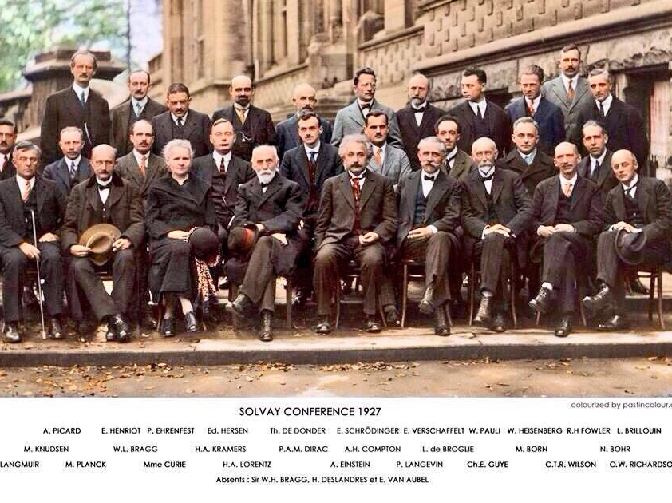
Notes:
Some debates you may be familiar with concern
SCIENCE AT THE LEVEL OF SOCIAL ORGANIZATION (famous pic, physics and chemistry conference)
KNOWLEDGE THAT is created by a very homogeneous group – nonwhite? Nonwestern? Social class, same education institution, women? (Marie Curie)
STILL TODAY in some fields...
Some people “do not have what it takes to succeed”?

Slide 3
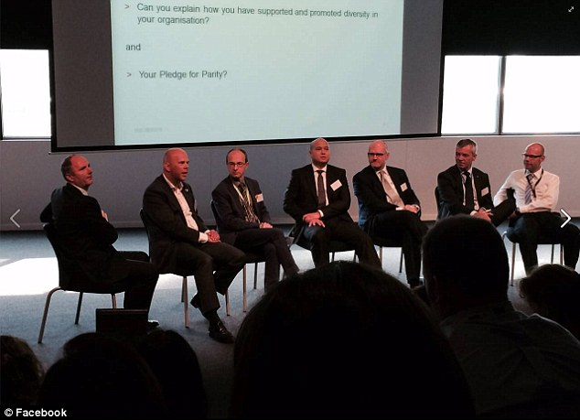
Manel of CEOs on women´s day event, Melbourne, Australia (2016)
Notes:
Not only “hard science” or biomedical science or but also other types of knowledge, e.g. practice-based or social science.
E.g. who has competencies to be the “the expert” or the spokesperson for diversity in an organization?
This made headlines.
Importance of terminology. “Manel” – coin new words – “the problem without a name”?

Slide 4
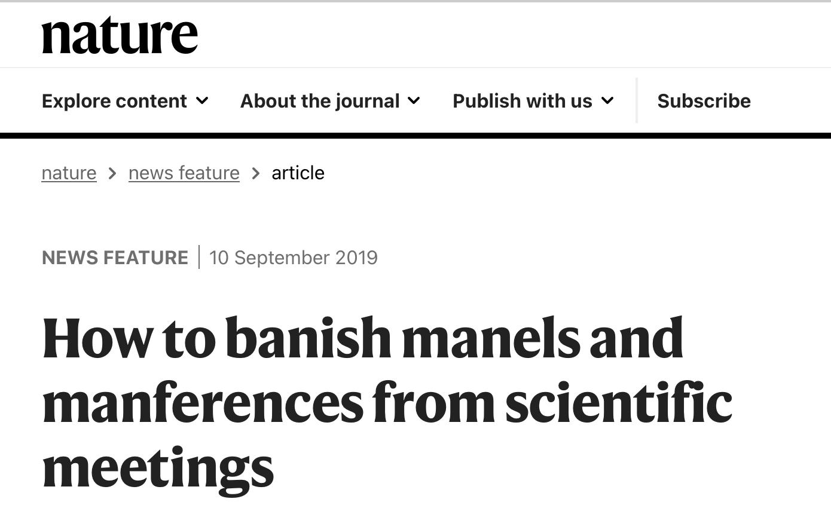
Notes:
Dominance translates into exclusionary practices in science
MANREFERENCES Citing each other form of recognition of (epistemic) authority
Social organization ←→ epistemic level!
Not enough that you have knowledge
You need others to recognize that, your peers
You are part of a network.
Hard to see that when you are alone in front of your computer…

Slide 5
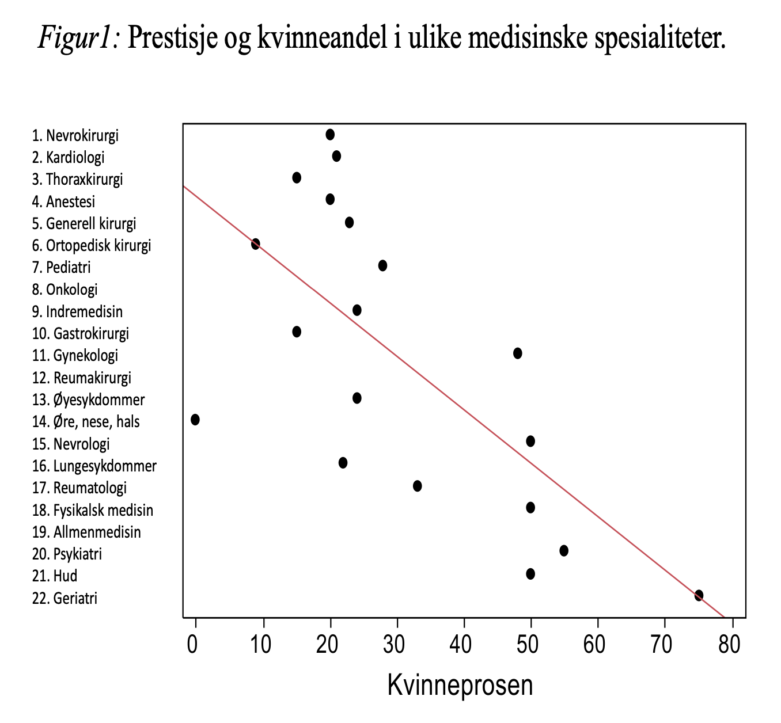
Henningsen & Liestøl 2013
Notes:
Social organization of science, status, epistemic authority and cognitive styles:
Crossing data from 2 different studies
- Dag Album (1991) Norwegian sociologist asked doctors and students to rank specialties by prestige ("Y-axis")
- Inge Henningsen investigated the proportion of women in the specialties at the University of Copenhagen ("x-axis")

Slide 6

Notes:
Prominent sociologists, booklet 1987
Epistemic authority and social location

Slide 7
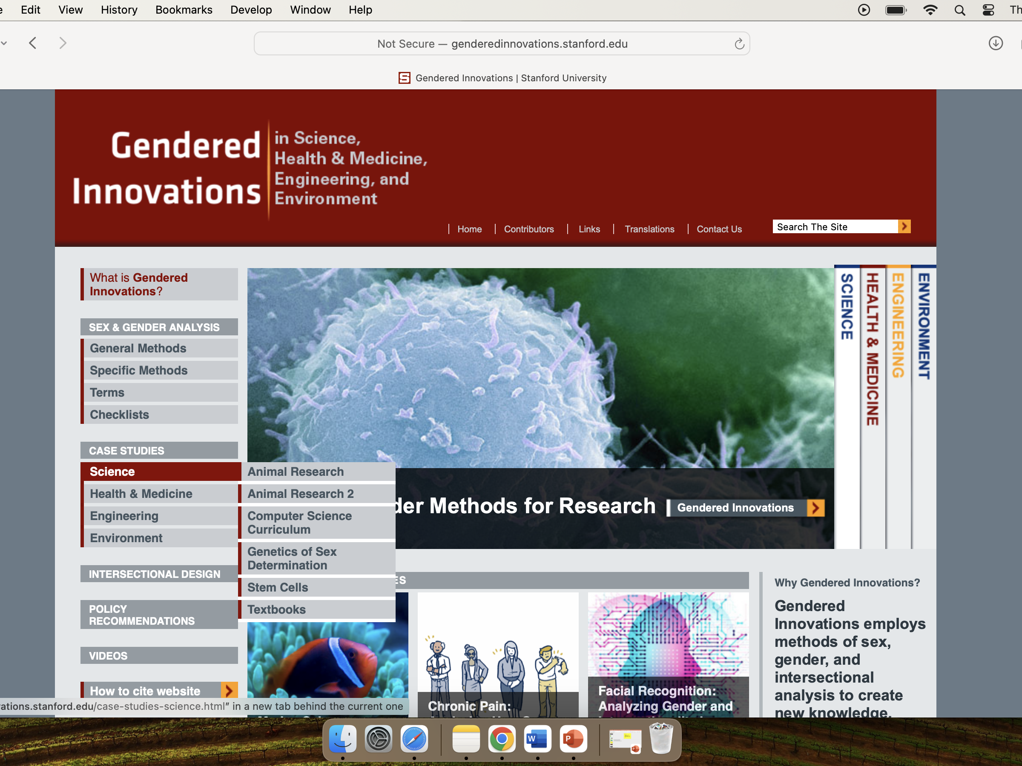
Notes:
HOW do dominant knowledge practices disadvantage women?
Read 2 examples:
genderedinnovations.stanford.edu
Case studies
The Challenge
THOMAS – this year the students are all in social science / qualitative research, so I did not use this slide

Slide 8
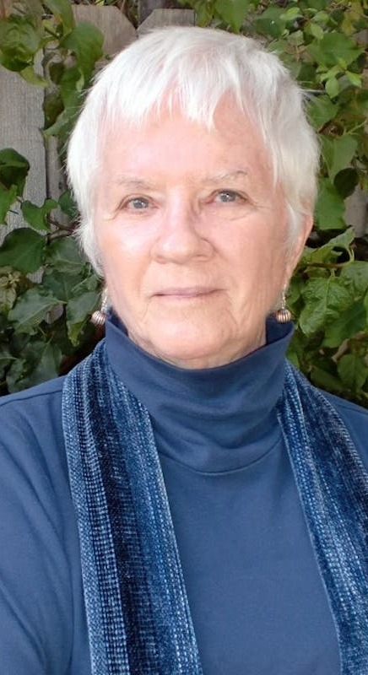
Sandra Harding (1935-)
Epistemology
Methodology
Standpoint theory
“Strong objectivity”
Notes:
Sandra Harding is Emerita from UCLA. Philosopher of science.
I assume you have already defined ”epistemology” in this course?
Epistemology = theory of knowledge. Episteme means knowledge. Branch of philosophy.
Question:
- What is valid knowledge? What is a well-founded belief?
- What is a valid method in research? How do acquire valid knowledge?
Relevant to philosophy of science, philosophy of the mind
Methodology BROADER CONCEPT than method. Research methods have an epistemological commitment (analysis strategy)

Slide 9
Sandra Harding (1935-)
Epistemology
Methodology
Standpoint theory
“Strong objectivity”
Notes:
In conventional accounts, in order to achieve the status of knowledge, beliefs are supposed to break free of-to go beyond-their ties to local, historical interests, values, and agendas.
Such beliefs only get to count as opinions. Not as knowledge. OBJECTIVIST EPISTEMOLOGY SOCIAL SCIENTIST AS VALUE NEUTRAL (WEBER)
What kinds of knowledge projects are objective and which aren’t?
Why?
Is objectivity necessary?
Is it possible to achieve objectivity?
How?
STANDPOINT EPISTEMOLOGY = EVERY KNOWLEDGE REFLECTS STANDPOINT OF KNOWER
“researcher bias” can never be removed
It is not possible to be a “neutral” researcher

Slide 10
Sandra Harding (1935-)
Epistemology
Methodology
Standpoint theory
“Strong objectivity”
Notes:
It is however possible to be an “objective” researcher
researcher reflexivity, or consideration of the researcher's positionality, and how that affects their research, as a "stronger" objectivity
Harding suggests that e.g. starting research from the lives of women "actually strengthens standards of objectivity” NOT RELATIVISM
Knowledge (and the possible biases affecting it) must be seen and assessed by the scientific community and located in social history.

Slide 11
Notes:
Active since 1970s
The Science Question in Feminism, 1986.
Whose Science? Whose Knowledge?: Thinking from Women's Lives, 1991.
Is Science Multicultural? Postcolonialisms, Feminisms, and Epistemologies, 1998.
Science and Social Inequality: Feminist and Postcolonial Issues, 2006.
Sciences From Below: Feminisms, Postcolonialities, and Modernities, 2008.
Objectivity and Diversity: Another Logic of Scientific Research, 2015.
What does that title mean?
Which leads me to the next scholar

Slide 12
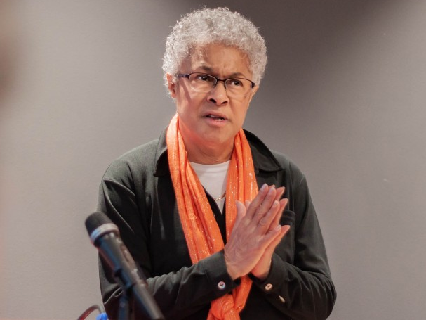
Patricia Hill Collins (1948-)
Notes:
EXCLUSION
Two working parents living in a Black, working-class neighborhood. Father factory worker. Now emerita at University of Maryland. 1st generation
More accessible than Harding or Haraway, sociological entry point to the discussion of epistemology. Active since late 1980s. In 1990, Collins published Black Feminist Thought
To understand human knowledge, we also need to look at which dynamics of inclusion and exclusion are in place in society. Particularly in key arenas such as universities and knowledge institutions that to an extent get to gatekeep on what counts as “valid” or “legitimate” knowledge

Slide 13
Patricia Hill Collins (1948-)
The “outsider within”
Notes:
“Outsider within” describes working class, black women’s position both in the social context and in academia –– learned from OWN POSITION, OWN EXPERIENCE.
When members of historically marginalized groups finally get to join organizations from which they had been historically excluded (e.g. herself as an academic), they do not join on equal terms as the historically privileged
They are WITHIN (academic), at the same time they are still OUTSIDERS. DUAL POSITIONING
Organizations (universities, scientific societies) have a hierarchy and a culture, that reflect their insider­ group control. Even after an organization becomes more diverse, typically the historically marginalized do not reach top positions. They can be seen a bit like intruders who do not fit with the culture. They as workers and their knowledge are attributed lower authority. WORKING CLASS BLACK WOMAN AS WIHTIN BUT DECENTERED – not an insider

Slide 14
Patricia Hill Collins (1948-)
The “outsider within”
Notes:
Could that position be a source of insight?
The outsider/within status challenges conscious and unconscious worldviews that dominate an organization OR a discipline, by giving a new perspective not always available to historically included.
This is what feminists do, exposing, problematizing the taken for granted, and learning through unlearning
Not only social dynamics in the organization, but also the knowledge, the science
The research questions that are asked, the issues that are seen as interesting and important. Our backgrounds and identities shape the questions we ask about the world.
Hill Collins was a social scientist, she was concerned with studying the oppression of black women, that was her object of inquiry. She argued that oppression is best visible from the position of the oppressed (but presupposes self-esteem and collective consciousness = OPPOSITIONAL CONSCIOUSNESS)
Blinded by privilege? = miss critical questions about the social and natural world

Slide 15
Patricia Hill Collins (1948-)
The “outsider within”
Notes:
oppositional consciousness: what enables individuals to attribute their discontent to structural, cultural and systemic causes rather than to personal failure
Society seen in terms of privilege and oppression
Conflict theory

Slide 16

Striving to become an insider
Challenging existing knowledge paradigms
Notes:
«In essence, to become sociological insiders, Black women must assimilate a standpoint that is quite different from their own.»
Striving to «to become an insider»? However, Hill Collins argues that it one must challenge existing knowledge paradigms
New questions, new theories, ADVANCING discipline
Being an insider is not (just) about numbers. Who gets to define the criteria for assessing knowledge? Who decides which knowledge is relevant?

Slide 17
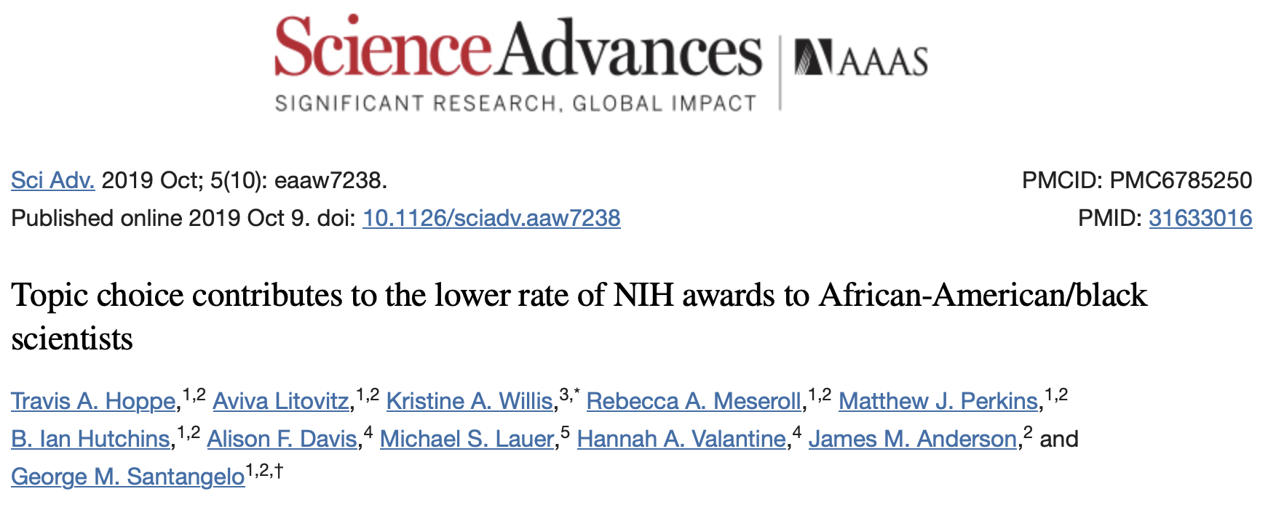
Notes:
Science can in principle investigate any part of the natural world, but scientific progress is only made on the questions
that scientists come up with
That get financing
Black scientists are more likely to study health inequalities than are white scientists –- and for that reason they may have troubles getting their research financed. NIH national institute of health USA.
So including black scientists may lead to more knowledge about health disparities and gendered innovation / racialized innovation. IF the value of that potential knowledge is recognized and gets financed. OUTSIDER WITHIN & INSIGHT. Research policies and research financing criteria also shaped by dominant groups in society
Women scientists are more likely to study pregnancy than are male scientists. Our backgrounds and identities shape the questions we ask about the world. Our social identities are situational and attached to specific histories of social injustice. Knowledge paradigms are not disconnected from lived experience.

Slide 18
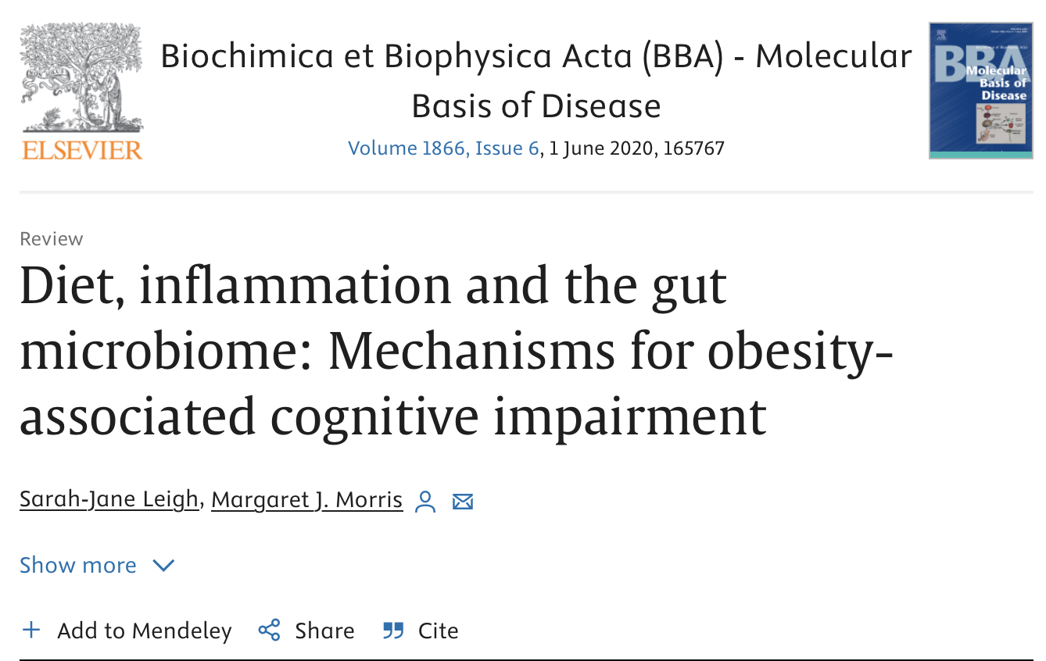

Notes:
Feminist epistemologies are about exclusion
In a society that is not racist/ageist/etc, some questions would not be asked – even in science
= flawed conceptions of knowledge, knowers, objectivity, and scientific methodology at play?

Slide 19

Notes:
Half a century ago, MIT played a critical role in the development of the flight software for NASA’s Apollo program, which landed humans on the moon for the first time in 1969.
Margaret Hamilton poses with the Apollo guidance software she and her team developed at MIT.
BA Mathematics
Software engineering was not yet an established discipline; instead, programmers learned on the job with hands-on experience

Slide 20
Notes:
When Hamilton started using the term "software engineering" during the early Apollo missions, software development was not taken seriously compared to other engineering. Hamilton was concerned with legitimizing software development as an engineering discipline. OUTSIDER WITHIN

Slide 21
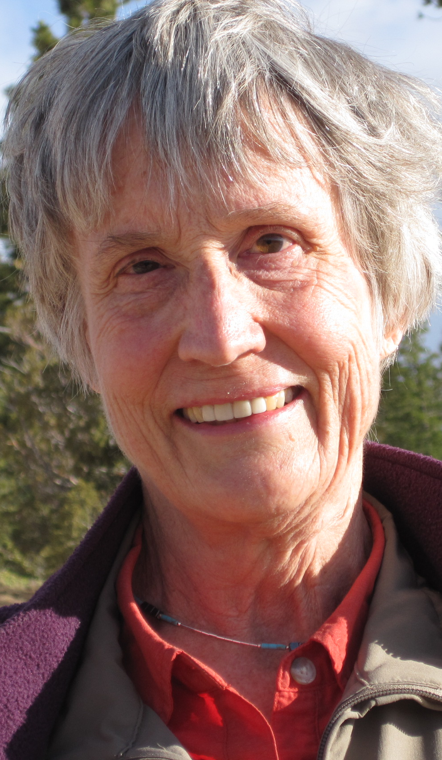
Donna Haraway
(1944-)
“Situated knowledge”
“Partial perspective”
“To play the God trick”
Notes:
Haraway majored in zoology, with minor in philosophy
Ph.D in biology
evolutionary philosophy (e.g. Darwin), theology
Active since late 1970s

Slide 22
Donna Haraway
(1944-)
“Situated knowledge”
“Partial perspective”
“To play the God trick”
Notes:
Social location and social identities of the knower

Slide 23
Donna Haraway
(1944-)
“Situated knowledge”
“Partial perspective”
“To play the God trick”
Notes:
Objectivity involves different ways of seeing – not just different standpoints – beyond taking into account multiple “standpoints” or giving voice to the oppressed

Slide 24
Donna Haraway
(1944-)
“Situated knowledge”
“Partial perspective”
“To play the God trick”
Notes:
MOST INTERESTING metaphor
Haraway plays with words and meaning (vision, lens)
Metaphors
Images to explain concepts

Slide 25
Vision and the lens
(metaphors)
Notes:
Notions of vision, viewpoints, eyes, and seeing have dominated many philosophical accounts of how knowledge is created at least since Plato's famous allegory of the cave.

Slide 26
Vision and the lens
(metaphors)
Embodied, technologically mediated, always partial
Notes:
Objectivity is about particular and specific embodiment
ONLY PARTIAL PERSPECTIVE PROMISES OBJECTIVE VISION
Feminist objectivity is about limited location and situated knowledge

Slide 27
Vision and the lens
(metaphors)
Embodied, technologically mediated, always partial
Infinite vision is an illusion: «to play the god trick»
Notes:
"a conquering gaze from nowhere”
it is claimed to have the capacity to see, but is itself unseen, "to represent while escaping representation"
Gaze is claimed to be immaterial, but what it sees is claimed to be material
Haraway proposes is embodied, partial, and accountable/answerable for what one sees and how one organizes what one sees.
Objectivity is then about particular and specific embodiment and definitely not about the false vision that promises the transgression of all limits.
location,embodiment,and partial perspective;

Slide 28

Where are you?
Notes:
Taking positioning seriously
According to conventional accounts of objectivity, the researcher (or local or international groups of researchers) LOOKS at the data.
You as a researcher learn to think of yourself as positioned/placed outside your data.
Not quite! And sometimes this is very obvious. E.g. Who interviewer is, influences answers
For other methodologies less obvious (e.g. non-obtrusive, non-reactive methods such as document analysis), but still (examples)

Slide 29
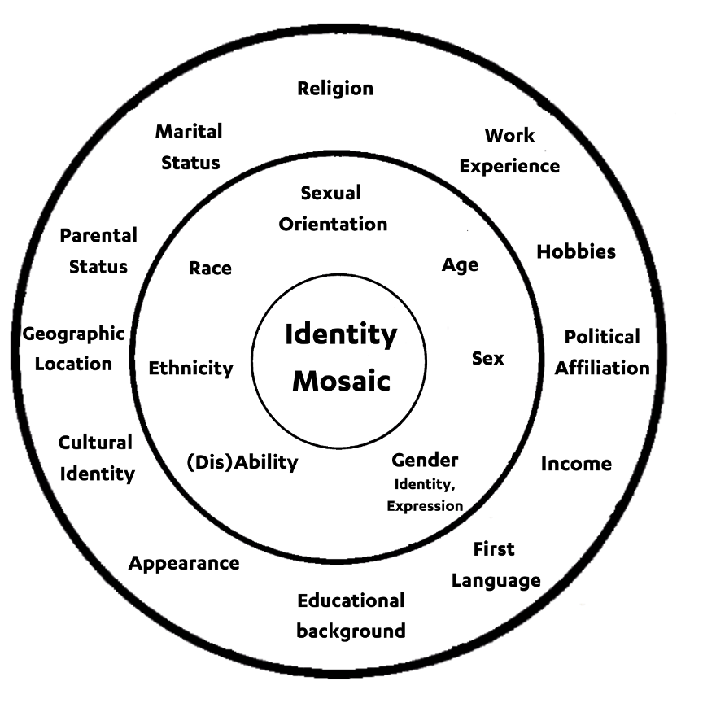
Notes:
Acknowledge that you look at phenomena through the lens of your social identity
Acknowledge that yours is not a “view from nowhere”. You are positioned. You are somewhere.
This disc mainly in terms of privilege/oppression, however there are other ways of going about this

Slide 30
What is reflexivity?
An account of how your subjectivity shapes your inquiry
Not an “acknowledgment of bias” – it does not make your research less valuable! On the contrary
Your subjectivity is not something you need to silence, neutralize, apologize for
Consciously critique, appraise, and evaluate how your subjectivity and context influence the research processes

Slide 31
Your social location situates you as a knowing subject
Your ascribed social identities (gender, race, sexual orientation, caste, class, kinship status, trans/cis etc.)
Your social relations and roles affected by these identities
The social norms that prescribe different virtues, habits, emotions, and skills thought to be appropriate for your role
Your subjective identity and that of other collaborators and informants — identities incorporated into their self-understandings
Your attitudes toward these ascribed identities, such as affirmation, rejection, pride, and shame.

Slide 32
Types of reflexivity
Personal. How are our unique perspectives influencing the research?
Interpersonal. What relationships exist and how are they influencing the research and the people involved? What power dynamics are at play?
Methodological. How are we making methodological decisions and what are their implications?
Contextual. How are aspects of context influencing the research and people involved?
Notes:
Where do you write this in your paper? Depends where it is relevant
Little space to do it in papers. Why? Epistemic privilege, dominant science practices
EXAMPLES from the course reading. There are boxes with clear examples of personal, interpersonal, methodological and contextual reflexivity statements

Slide 33
Team-reflexive discussion: example
In what way might my experience shape my participation in the project?
What experiences have I had with qualitative research?
What is my orientation to qualitative research?
What results do I expect to come out of this project?
What theories do I tend to favor while analyzing data?
What is my stake in the research? What do I hope to get out of it?
What are my fears?

