Slide 1
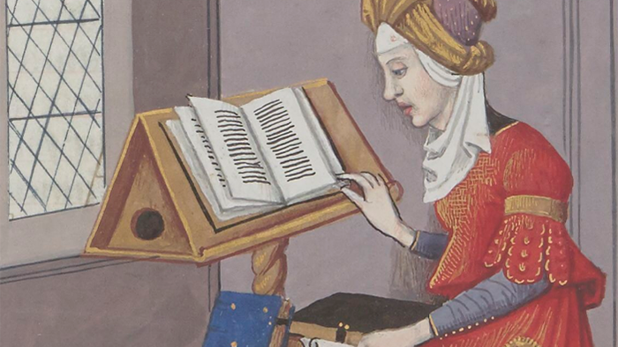
The role of the body and literacy in research
Mattias Solli
Philosopher and researcher
Department of Philosophy and Religious Studies NTNU

Slide 2
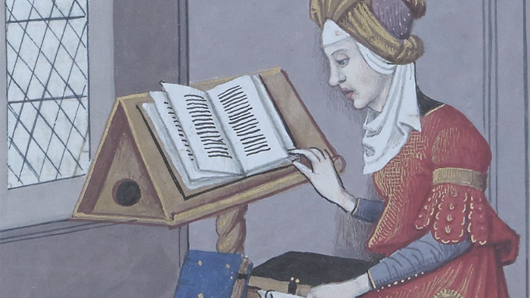
Plan
Body
Literacy
…. what if things were different?

Slide 3
What do you think?
What is the role of the body
and literacy in knowledge production?

Slide 4

No body, no knowledge
Banal. “Yeah. It is a necessary condition. So?
Profound. “How does the body shape our production of knowledge?
No text, no distribution of knowledge
Banal. “Yeah. We write down ideas and read the ideas of others. So?
Profound. “How does literacy shape our production of knowledge?
Profound. “Is literacy a necessary condition for knowledge production?
Enabling conditions

Slide 5
Unpack philosophical implications of texts
Use philosophical perspectives for discussion
  —apply the philosophical perspectives to ourselves
  Exemplify non-scriptural and embodied knowledge (jazz)
Purpose

Slide 6
Plan
Body
  Bringing the body into view
  Knowledge production seen from the lived body’s perspective
  Embodied attention as openness and closedness

Slide 7
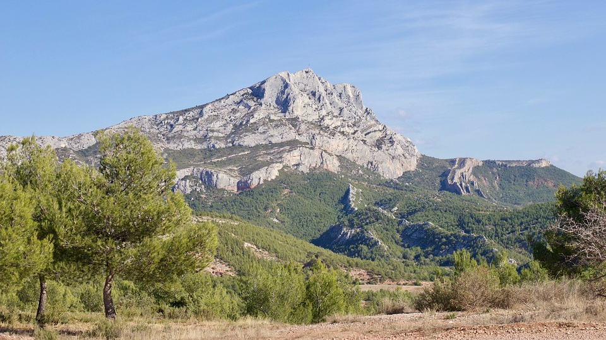


Primacy of perception
Rationality, values, and existence are perceptual phenomena.
They are acted out by real, living bodies: You, me – us, the humans.
Merleau-Ponty, Primacy of Perception

Slide 8
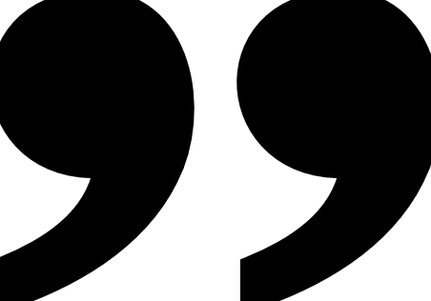
Primacy of perception
The perceived world is the always presupposed foundation of all rationality, all value and all existence.
This thesis does not destroy either rationality or the absolute. It only tries to bring them down to earth.
Merleau-Ponty, Primacy of perception, p. 13

Slide 9
Primacy of perception
We must rediscover the structure of the perceived world through a process similar to that of an archaeologist.
For the structure of the perceived world is buried under the sedimentations of later knowledge.
Merleau-Ponty, Primacy of perception, p. 5

Slide 10
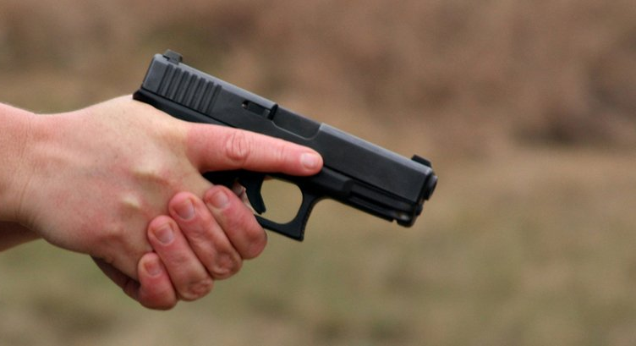
Example
Do weapons
embed human values?

Slide 11






Theoretical knowledge
Practical knowlegde
Ethics
Knowledge about the world
Propositional knowledge
Accurate descriptions
Knowing What
Knowing how to do things
Arts and crafts
Sports
Nursing, physiotherapy
Western philosophical tradition
Dividing human competence
Knowing good conduct
Values and principles we live by
Plato, The Republic – and onwards

Slide 12


Plato
René Descartes (1596-1650)
Rational
Desire
Practical
Rational
Western tradition
Dividing
the human
Soul (eternal) partaking in body and environment
Rational organization
Dualist tendencies
Plato, The Republic; Phaidon
Body and soul separate
Soul is rational self-reflection
Soul can and should follow method
Body is mechanism
Sharp dualism
Mind and environment separate
Descartes, Meditations on First Philosophy

Slide 13
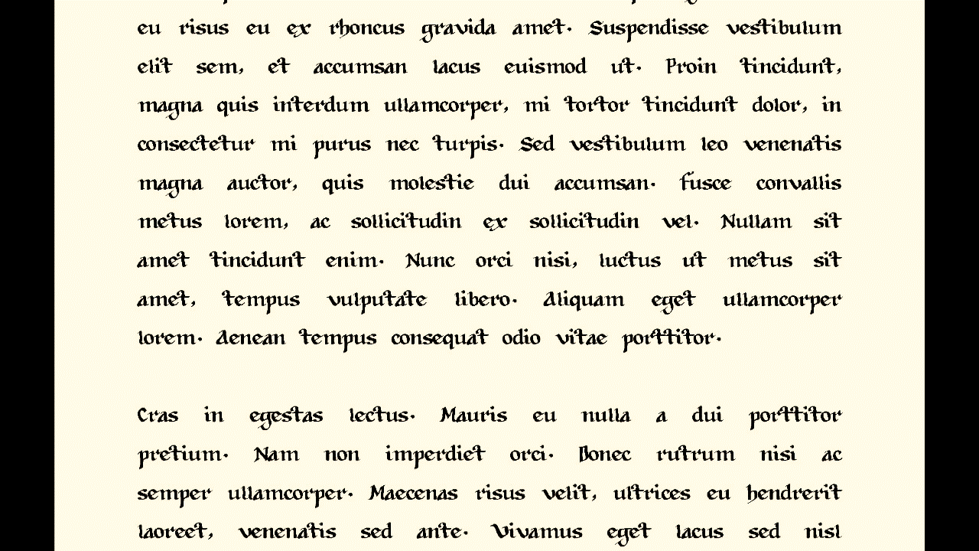
Separating knower and known
The
written word
Technology for information distribution
Person-independent
Transgresses time and place
Accumulating common knowledge
Favors intellectual understanding?
Ong, Interfaces of the Word; Havelock, Preface to Plato; Gadamer, The Beginning of Philosophy

Slide 14
Why do you think humans downplay the body’s role in knowledge production?
How is it in your research field?

Slide 15
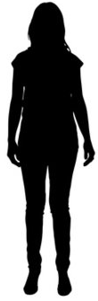
Körper
Leib
Physical body
Third-person perspective
Experienced body
Different perspectives on/from the same body
Lived body
First-person perspective
Experiencing body
Holistic experience
Lived perspective
Husserl, Ideen 2; Zahavi, Husserl’s Phenomenology of the body

Slide 16
When everything works, it’s just there – in the background
Body
Language
Health
Tools
Routines
Agreement
Moral
Tradition
Lifeworld
Merleau-Ponty, Phenomenology of perception; Heidegger, Being and Time: Gadamer, Truth and Method
Lived
experience
Self-concealment

Slide 17


Lived experience
Consciousness as directedness
Consciousness
is consciousness of something
is consciousness of itself as a consciousness of something
  How we do things
  Sub- or pre-conscious structures of behavior
c
FOREGROUND
BACKGROUND
Sartre, Being and Nothingness

Slide 18
Knowing that
Knowing how
Aspects of knowledge
Knowing that
Knowing how (you act, for instance, when you see what you see)
Molander, Practice of Knowing, 52 ff. Distinction from Ryle
FOREGROUND
BACKGROUND

Slide 19
Plan
Body
  Bringing the body into view
  Knowledge production seen from the lived body’s perspective

Slide 20
Practice is prime
Subjective and collective
Explicit and tacit knowledge
In its living heart, knowledge is embodied knowledge.
You can do more than you know.
Molander, Practice of Knowing p. 66 and 77

Slide 21
Practice is prime
Subjective and collective
Explicit and tacit knowledge
We discover beneath intelligence and beneath perception a more fundamental function.
… a global, practical, and implicit notion of the relation between our body and things, of our hold on them.
Merleau-Ponty, Phenomenology of Perception, 137
Merleau-Ponty, Primacy of Perception, 5

Slide 22
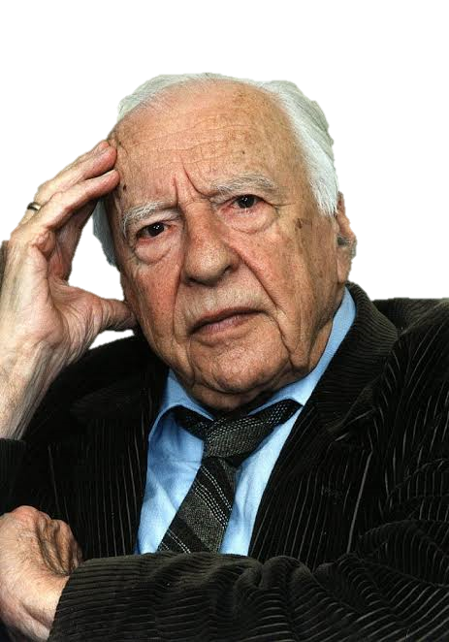
Practice is prime
And this is where the prejudices can be most powerfully at work.

Slide 23
Attention is key
Foreground
Background
Whats and Hows
Understanding means, primarily, to understand oneself in the thing that one tries to understand [Sich in der Sache verstehen]
Gadamer, Wahrheit und Methode, 299

Slide 24
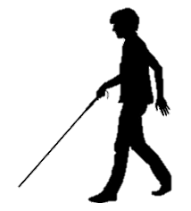

Environment affords behavior…
We enact possibilities
Active probing
  Sensorimotor
  Affective
  Symbolic
Exploration
Orientation
Body schema & image
Merleau-Ponty, Phenomenology of Perception; Gibson. The ecological approach to visual perception.

Slide 25
Gadamer: Application!
Truth and Method, 310-321
How do you enact your way in your research field?
What do you use for orientation?
What do you do when the method does not fit the phenomenon you are about to explore?
How much of this is expressed and how much is tacit knowledge?
Write down three or four points that capture your activity.
Orientation
Goals
Values
Objectivity
Subjectivity
The perspective of others
Questions
Norms
Examples
Familarities
Justifications
Sorting relevant facts
Tools
Forces
Overview
Research field

Slide 26
Methods
as ways to proceed
Methods
Securing correct, shared, and transparent procedure
Objectivity
Truth as Veritas (not Aletheia)
Person-independent and objective
… yet always acted out by someone, somewhere
  … not like following a rule blindly, is it?
Whoever wants to learn a science has to learn to master its methodology. But we also know that methodology as such does not guarantee in any way the productivity of its application.
Gadamer, Universality of the hermeutical problem, 11
Research field

Slide 27
How do you enact your way in your research field?
What do you use for orientation?
What do you do when the method does not fit the phenomenon you are about to explore?
How much of this is expressed and how much is tacit knowledge?
Write down three or four points that capture your activity.
Orientation
Goals
Values
Objectivity
Subjectivity
The perspective of others
Norms
Questions
Examples
Justifications
Sorting relevant facts
Tools
Forces
Overview
Research field

Slide 28
Plan
Body
  Bringing the body into view
  Knowledge production seen from the lived body’s perspective
  Embodied attention as openness and closedness

Slide 29
Primacy of perception
Openness towards other perspectices
Can I seriously say that I will always hold the ideas I do at the present – and mean it? Do I not know that in six months, in a year, even if I use the same formulas to express my thoughts, they will have changed their meaning slightly?
Merleau-Ponty, Primacy of perception, p. 5

Slide 30
Two ways of engaging in knowledge production
Model 1
Ego-centered
Personal goals-oriented
Rational and controlled
Criticism difficult
Model 2
Dialogical
Task-oriented
Criticism welcomed
Making of well-informed and free choices is favored
Molander, Practices of Knowing, 171-2; Donald Schön, Education the Reflective Practitioner, 257-8

Slide 31


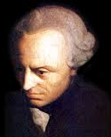
Determining judgment
Reflective judgment
Two kinds
Judgment
Apply known rule or category on a particular phenomenon
Known category
Particular
Seek new rules or categories faced with a particular
Unknown rule or category
Particular
Kant (2000); Dewey (2005); Gadamer (2004)

Slide 32
How do Models 1 and 2 steer your knowledge production?
What exemplifies determining and reflective judgment in your work?

Slide 33
Plan
Body
  Bringing the body into view
  Knowledge production seen from the lived body’s perspective
  Embodied attention as openness and closedness
Literacy
  What’s up?
  Historical background
  What does it mean today, from the embdodied perspective?

Slide 34
Enables thought processes inconceivable without
“Moving information” misleading idea
More significantly “within” the mind than outside it
Printed words considered more “real” than spoken words
Neatly associated with intellectualization, “minds eye”
Literacy
Writing and print and the computer enable the mind to constitute within itself – not just on the surface or on the computer programs – new ways of thinking, previously inconceivable questions, and new ways of searching for responses.
The mind does not enter into the alphabet or the printed book or the computer as much as the alphabet or print or computer enters the mind, producing new states of awareness there.
Ong, Interfaces of the Word, p. 47
Ong, Interfaces of the Word

Slide 35
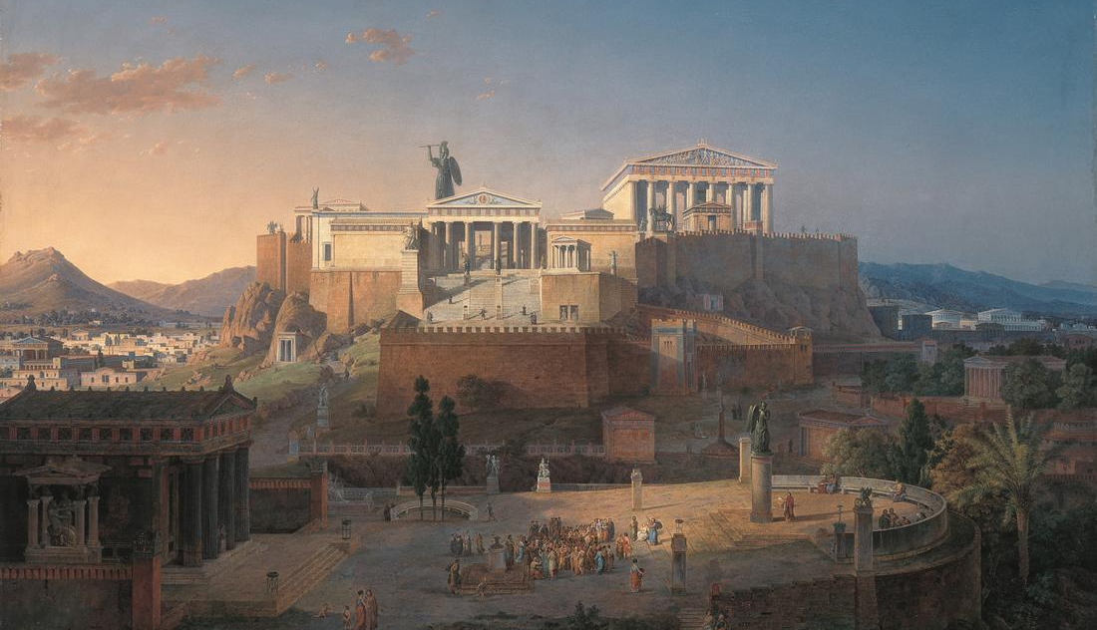
Though relates to itself
Around 500 BC
No coincidence that
philosophy emerges with the alphabet
Fixating points in language
Thought relates to itself
Alienation
AbstractionLanguage «consists of» phonetic units

Slide 36
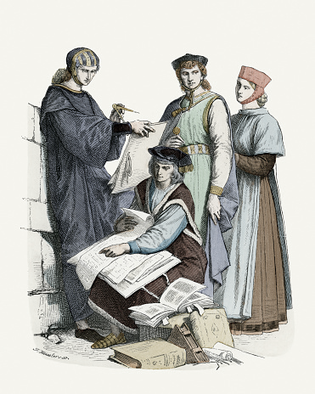
No coincidence that
Learned Latin was the language of academia
Cut off from mother tongue
Learned with the help of writing
Book language
Language for abstract formulas
Male activity
The entire academic enterprise out of which modern science emerged has been conducted in an international no man’s language.
Ong, Interfaces of the Word, 38

Slide 37
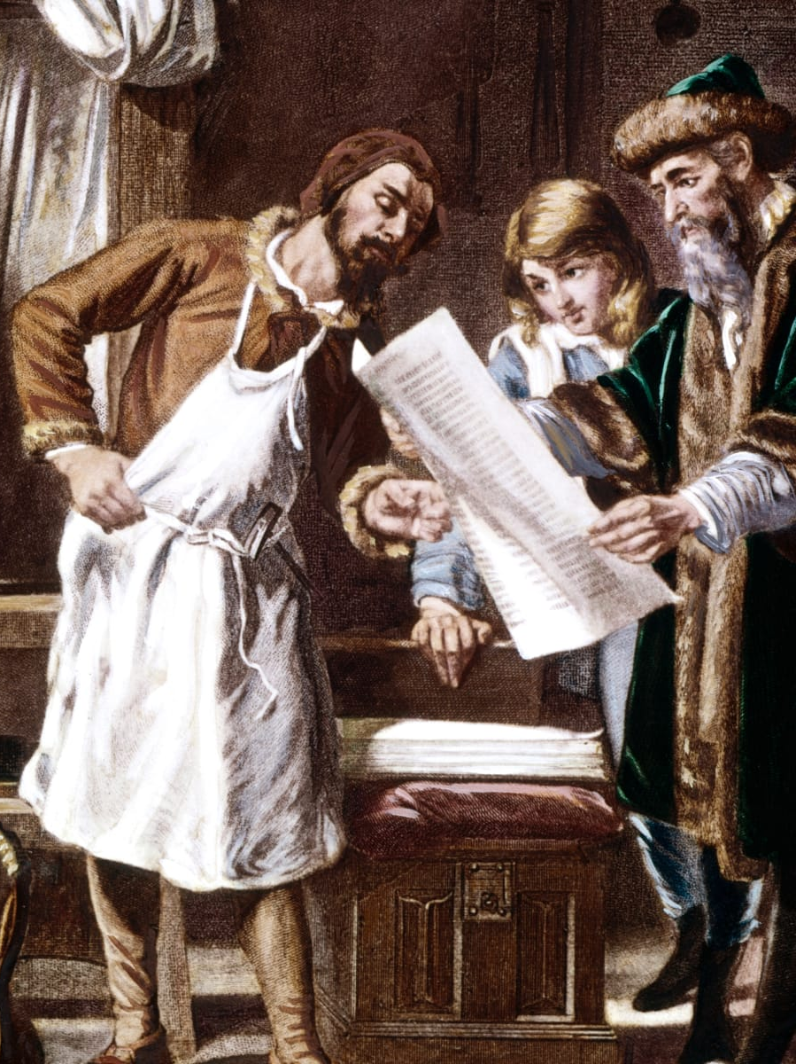
No coincidence that
new print technology intensified processes
Large-scale book production
  Large-scale abstraction
Democratization
  More people receiving education
  Girls in schools
  Women in Academia
Diversity
  More voices
  Globalization
Critical thought
  Questioning of authorities

Slide 38
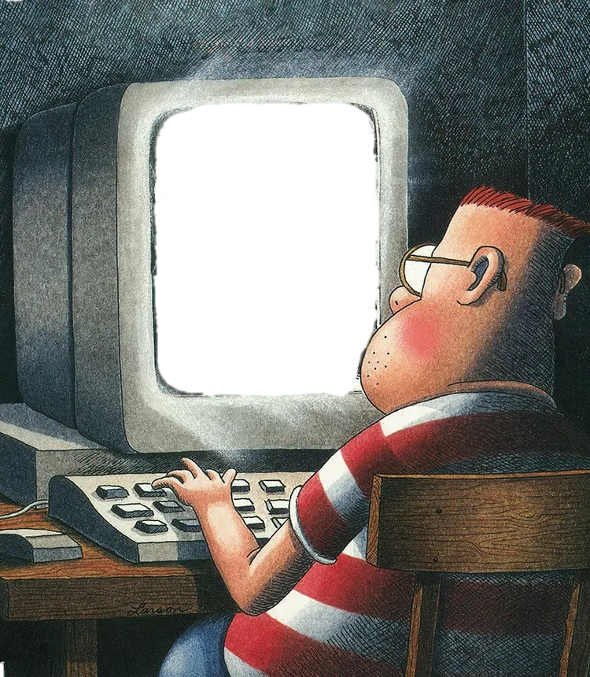
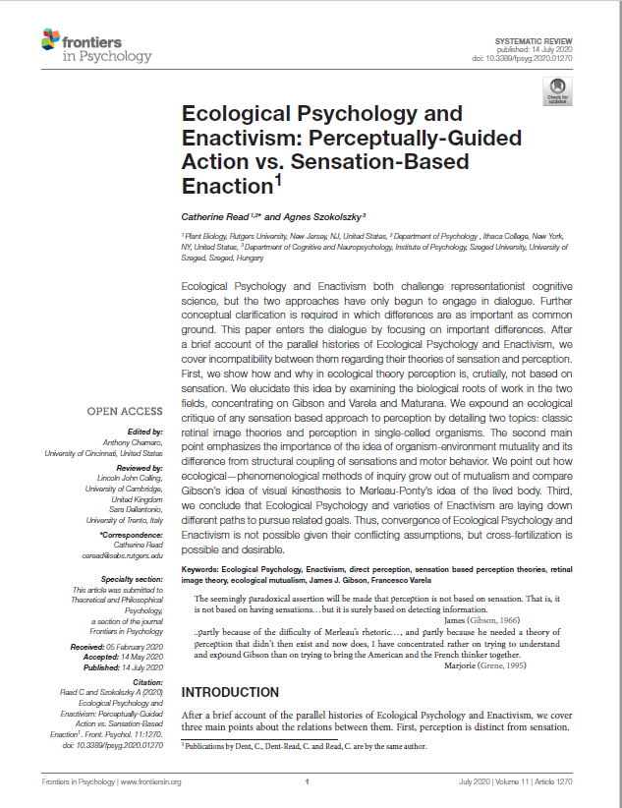
Language: Academic English
Format: Short papers
Incentive: The more, the better
Condition: Competition and time pressure
Popular set-up: Interdisciplinary dialog
Tools: Computer and internet
Academic literacy today?

Slide 39
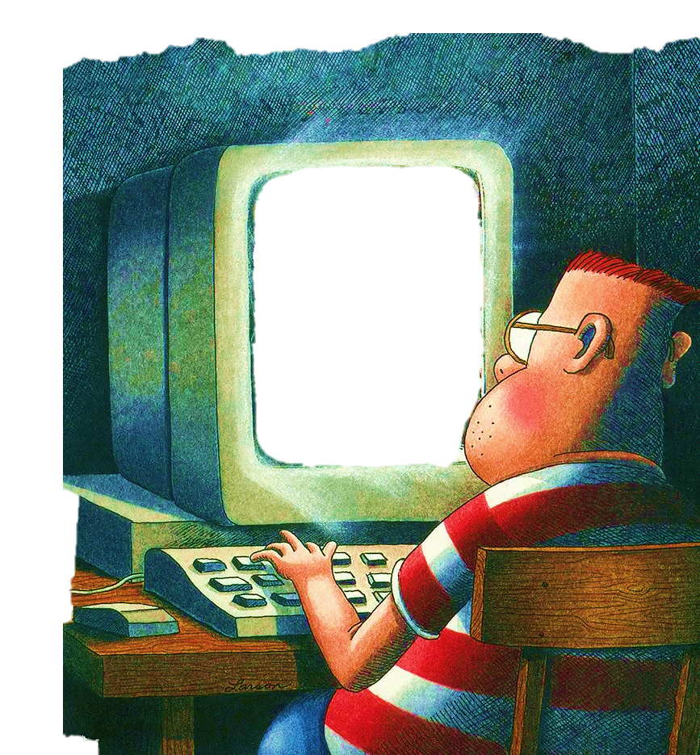
How does contemporary literacy influence your knowledge production?

Slide 40
Plan
Body
  Bringing the body into view
  Knowledge production seen from the lived body’s perspective?
  Embodied attention as openness and closedness
Literacy
  What’s up?
  Historical background
  What does it mean today, from the embodied perspective?
…. what if things were different?

Slide 41

Academic hiearchy?
The printed word is [assumed to be] the real word.
Ong, Interfaces of the Word, 21
Written knowledge higher status
Misinterpretation of non-scriptural knowledge systems?

Slide 42
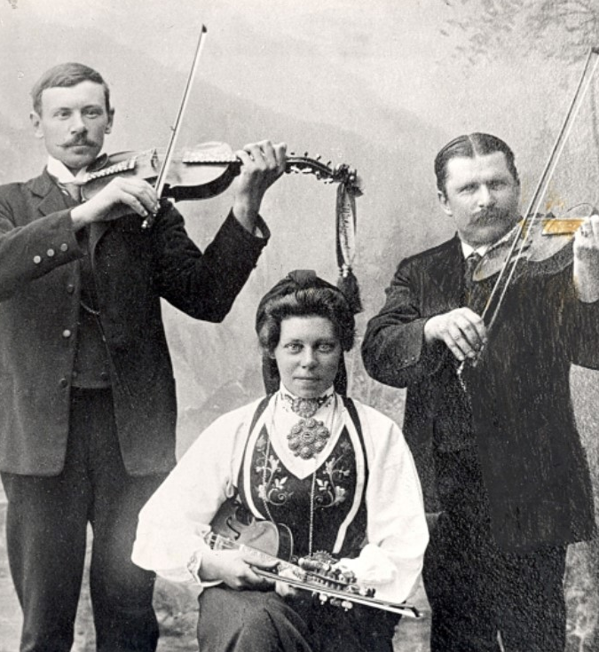
Examples
Contemporary non-scriptural knowledge systems
Folk music
Jazz

Slide 43
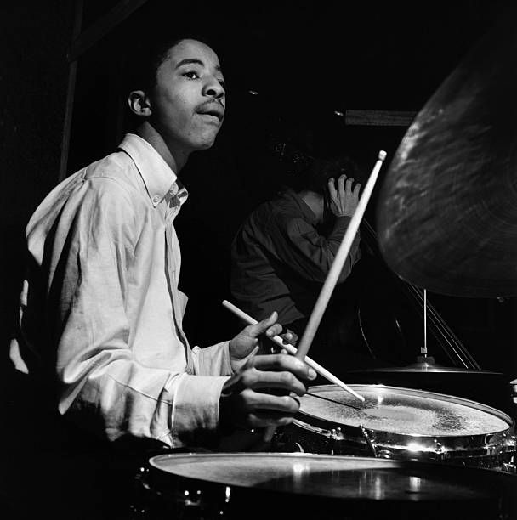

I can go on a long time singing this stuff
Tony Williams

Slide 44

Aural-musical learning
Very precise imitation
Embodied learning
Exploring aural-musical communication
Developing generative powers in music
No intellectualization
No use of written material
Solli, Aksdal and Inderberg, (2021). ‘Learning the jazz language by aural imitation: a usage-based communicative jazz-theory (Part 1 and (Part 2).

Slide 45

Aural-musical learning
hear not only how things are played, but also how they could be played
follow the musical attention of the other
lead the attention of the other towards self-perceived musical potentialities
Structural similarities to fundamental language acquisition
Develops reflective judgment in music
Solli, Aksdal and Inderberg, (2021). ‘Learning the jazz language by aural imitation: a usage-based communicative jazz-theory (Part 1 and (Part 2).

Slide 46



How do you value non-scriptural knowledge systems within academia?
If you were to study a non-scriptural knowledge system, how would you approach it?

Slide 47
Plan
Body
  Bringing the body into view
  Knowledge production seen from the lived body’s perspective
  Embodied attention as openness and closedness
Literacy
  What’s up?
  Historical background
  What does it mean today, from the embodied perspective?
…. what if things were different?

Slide 48
Than you for your attention

